Slide 1
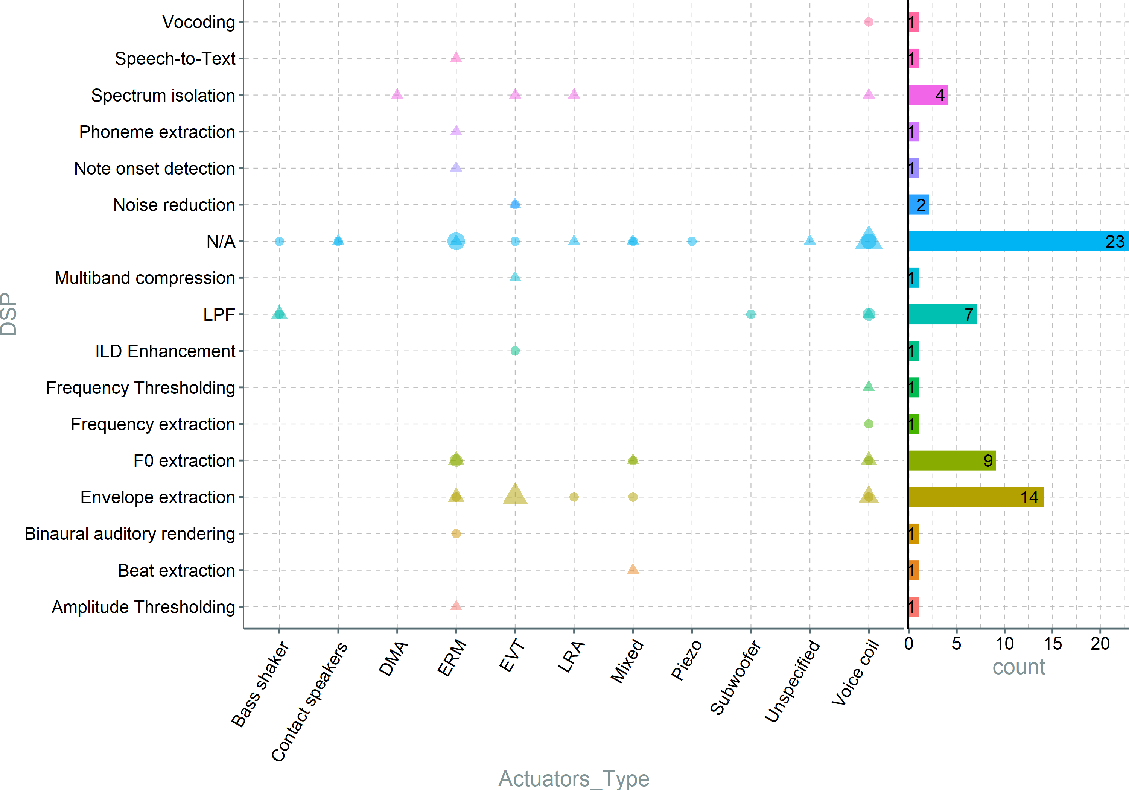
Notes:
ERMs are using all kind of DSP, same with voice coil. This indicates that there is no preffered way to use any particular DSP-actuator combination. This could be something to look into – What DSP would fit best what type of actuator. Voice coils (including subs) are generally used for pitched based DSPs)

Slide 2
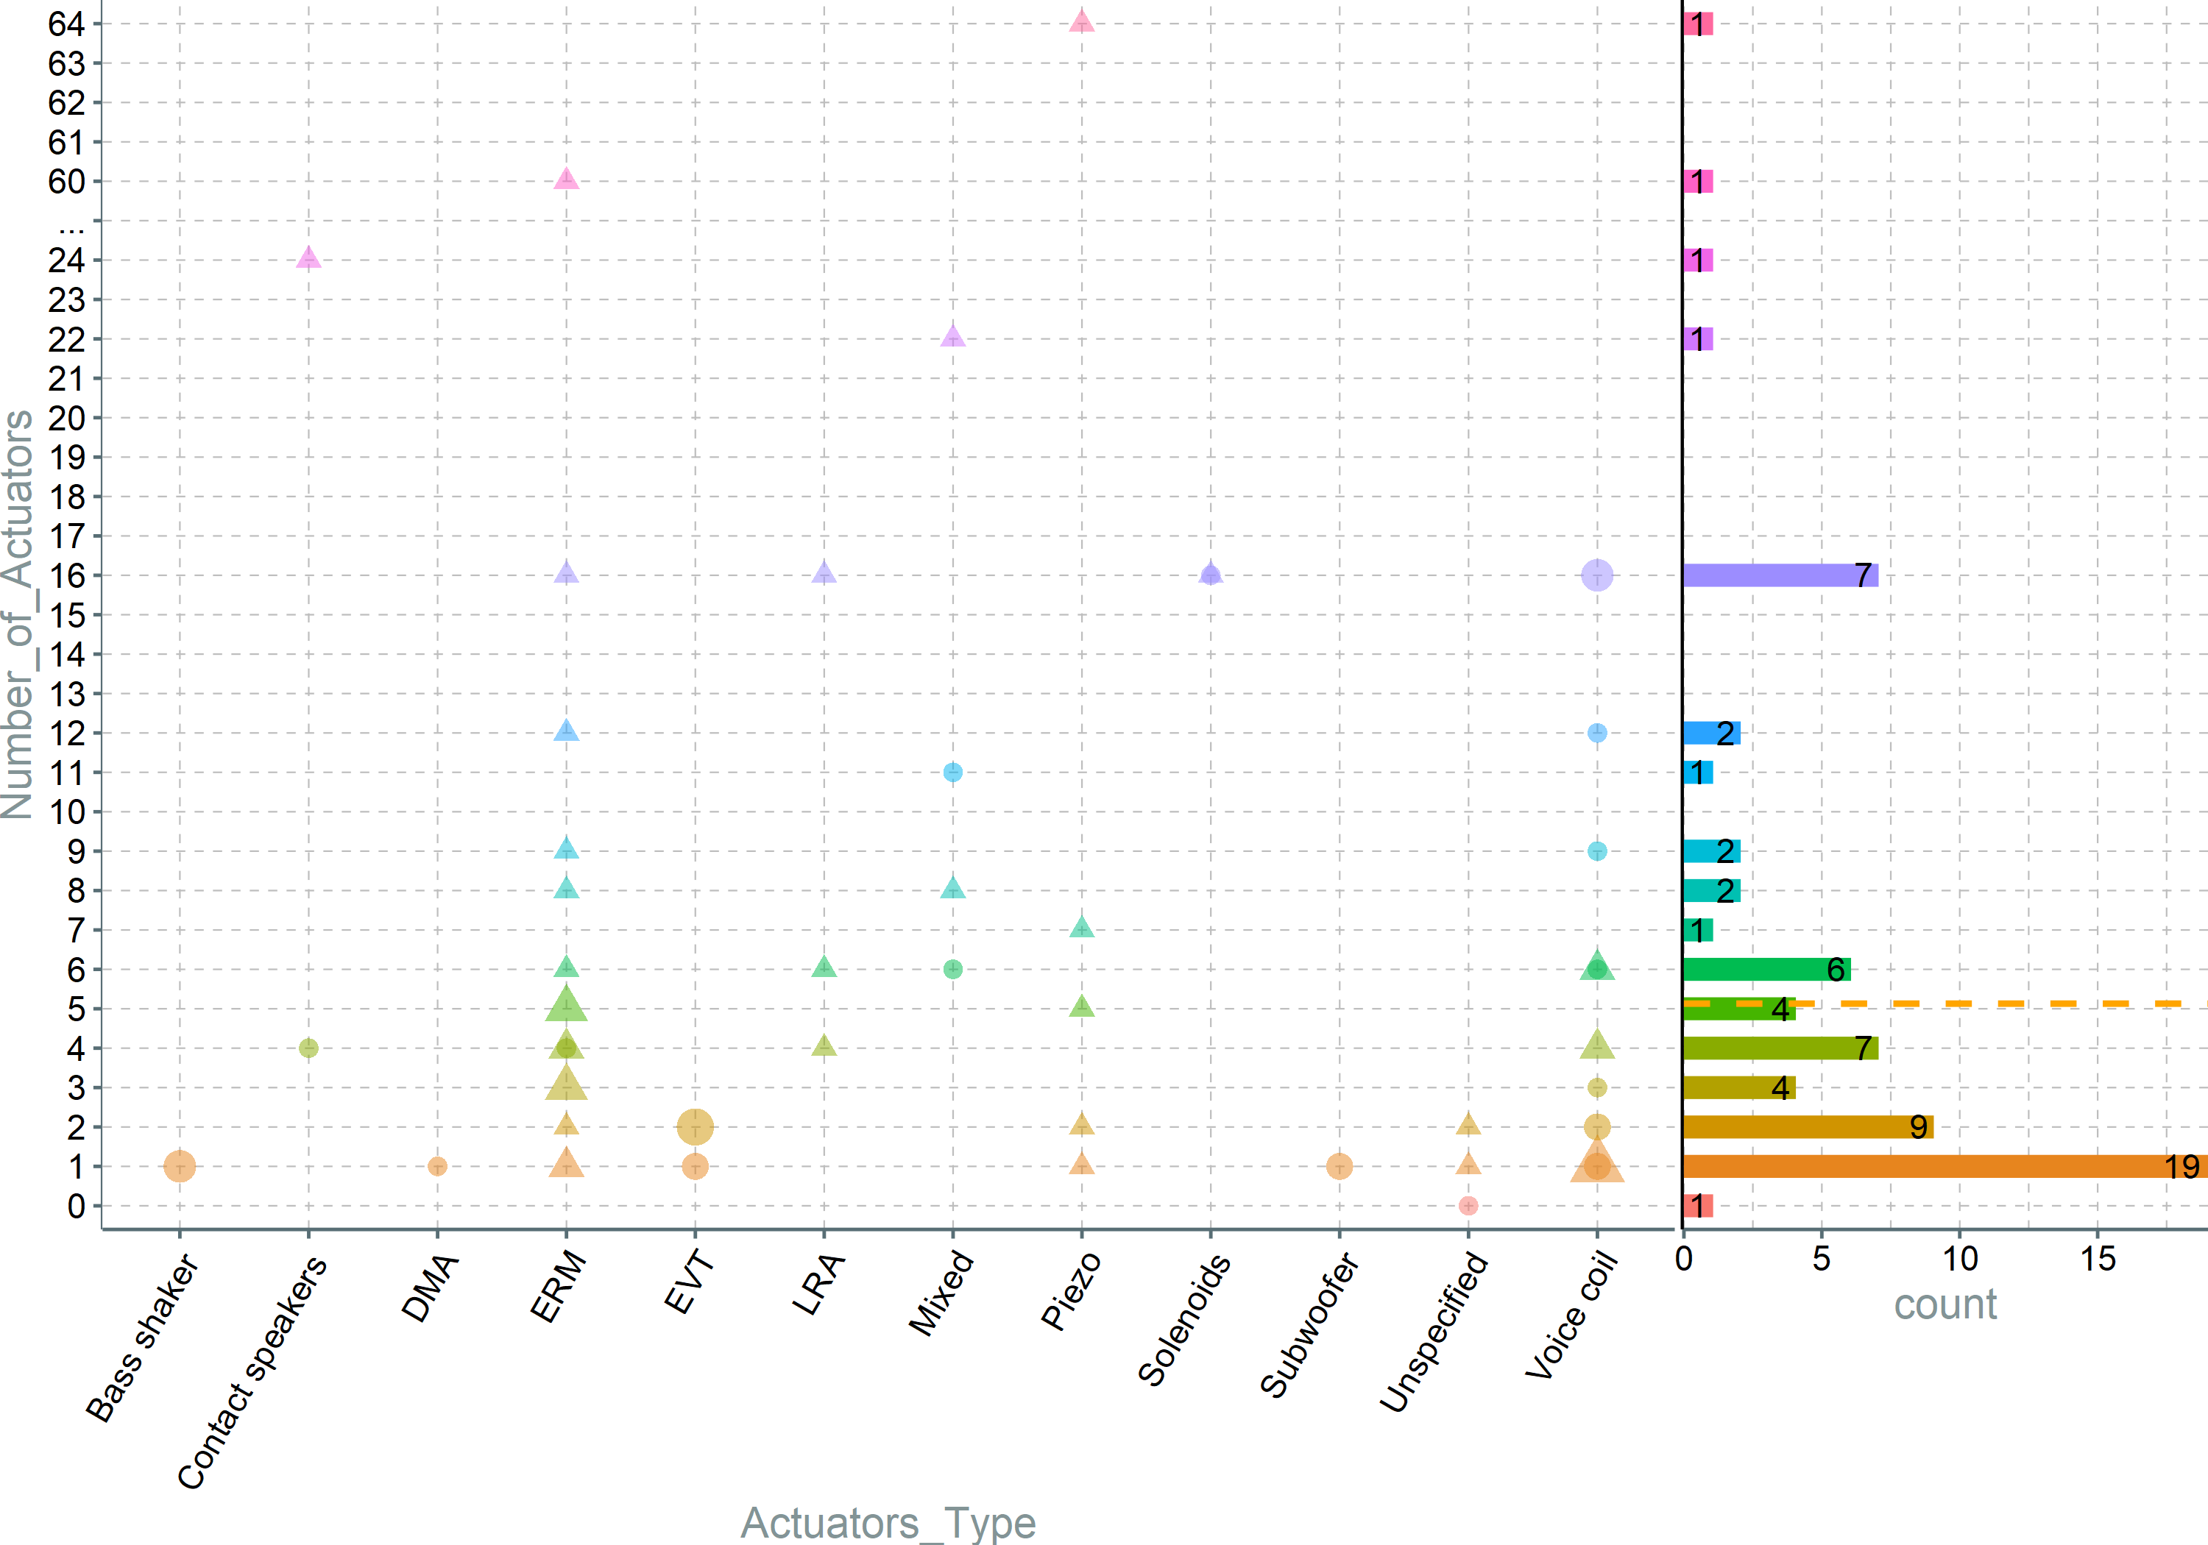
Notes:
Speakers are rarely used alone, but ERMs and voice coils are used in all kinds of combinations. Bass shakers and subs are used solitary(as expected),

Slide 3
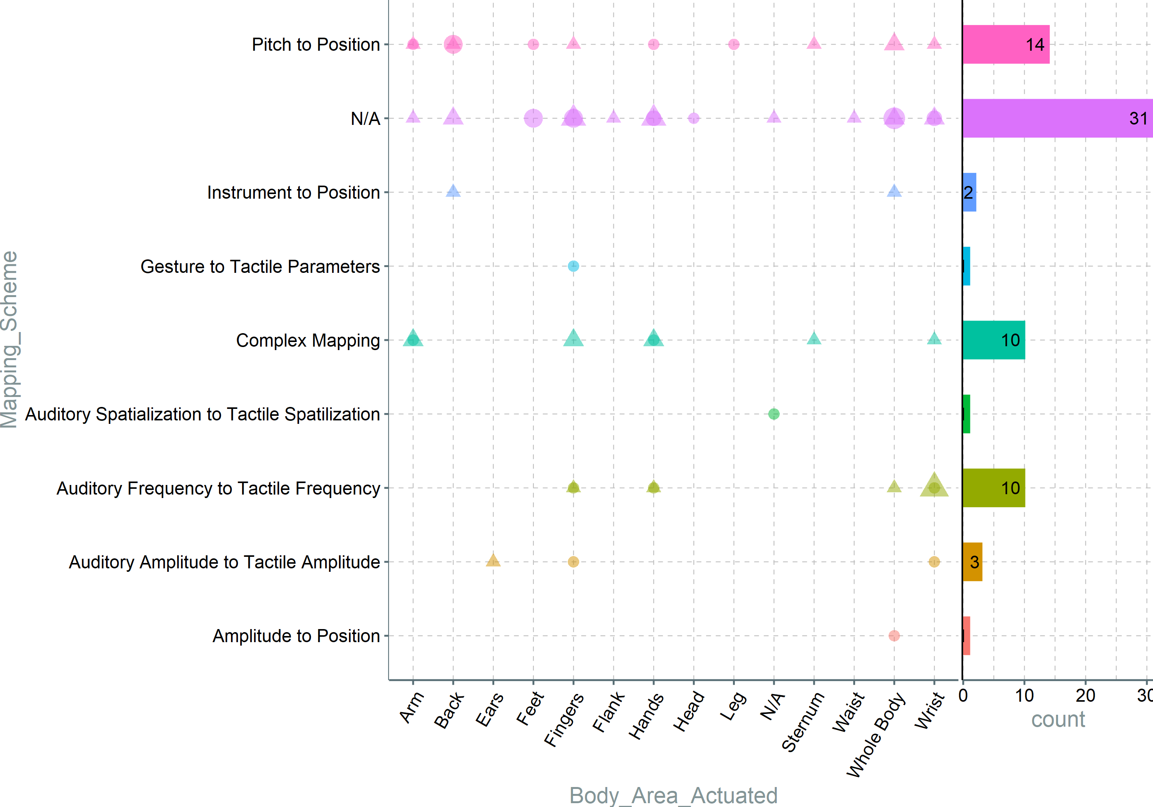
Notes:
Pitch to position (besides being the most popular – similar to a CI – worth a separate discussion to begin with) is used all over the body; same with no mapping(have to investigate this a bit). Auditory frequency – tactile frequency is mainly used on the hands, since there is a higher requirement for tactile frequency discrimination, and the hands provide the best.

Slide 4
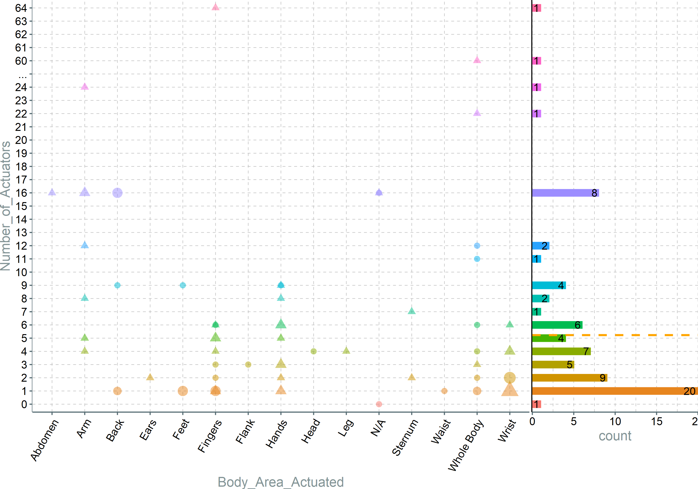
Notes:
Systems that use fingers are using a small nr of actuators, probably 1 actuator/finger. Similarly, for the writs, it seems that a small nr of actuators is preferred, probably because of physical limitations. On the other when the whole body is used, the number of actuators increases; the same for arms. This could indicate that the size of the actuator, as well as the spatial resolution of the skin, are a constraining factor in designing complex systems, and advancements in actuator tech could allow designers to cram more actuators aiming at the high sensitivity areas (hands, wrist, etc). It is know that there is a positive correlation between 2-point discrimination and contact size of the actuator, so small actuators would require smaller space between them.

Slide 5
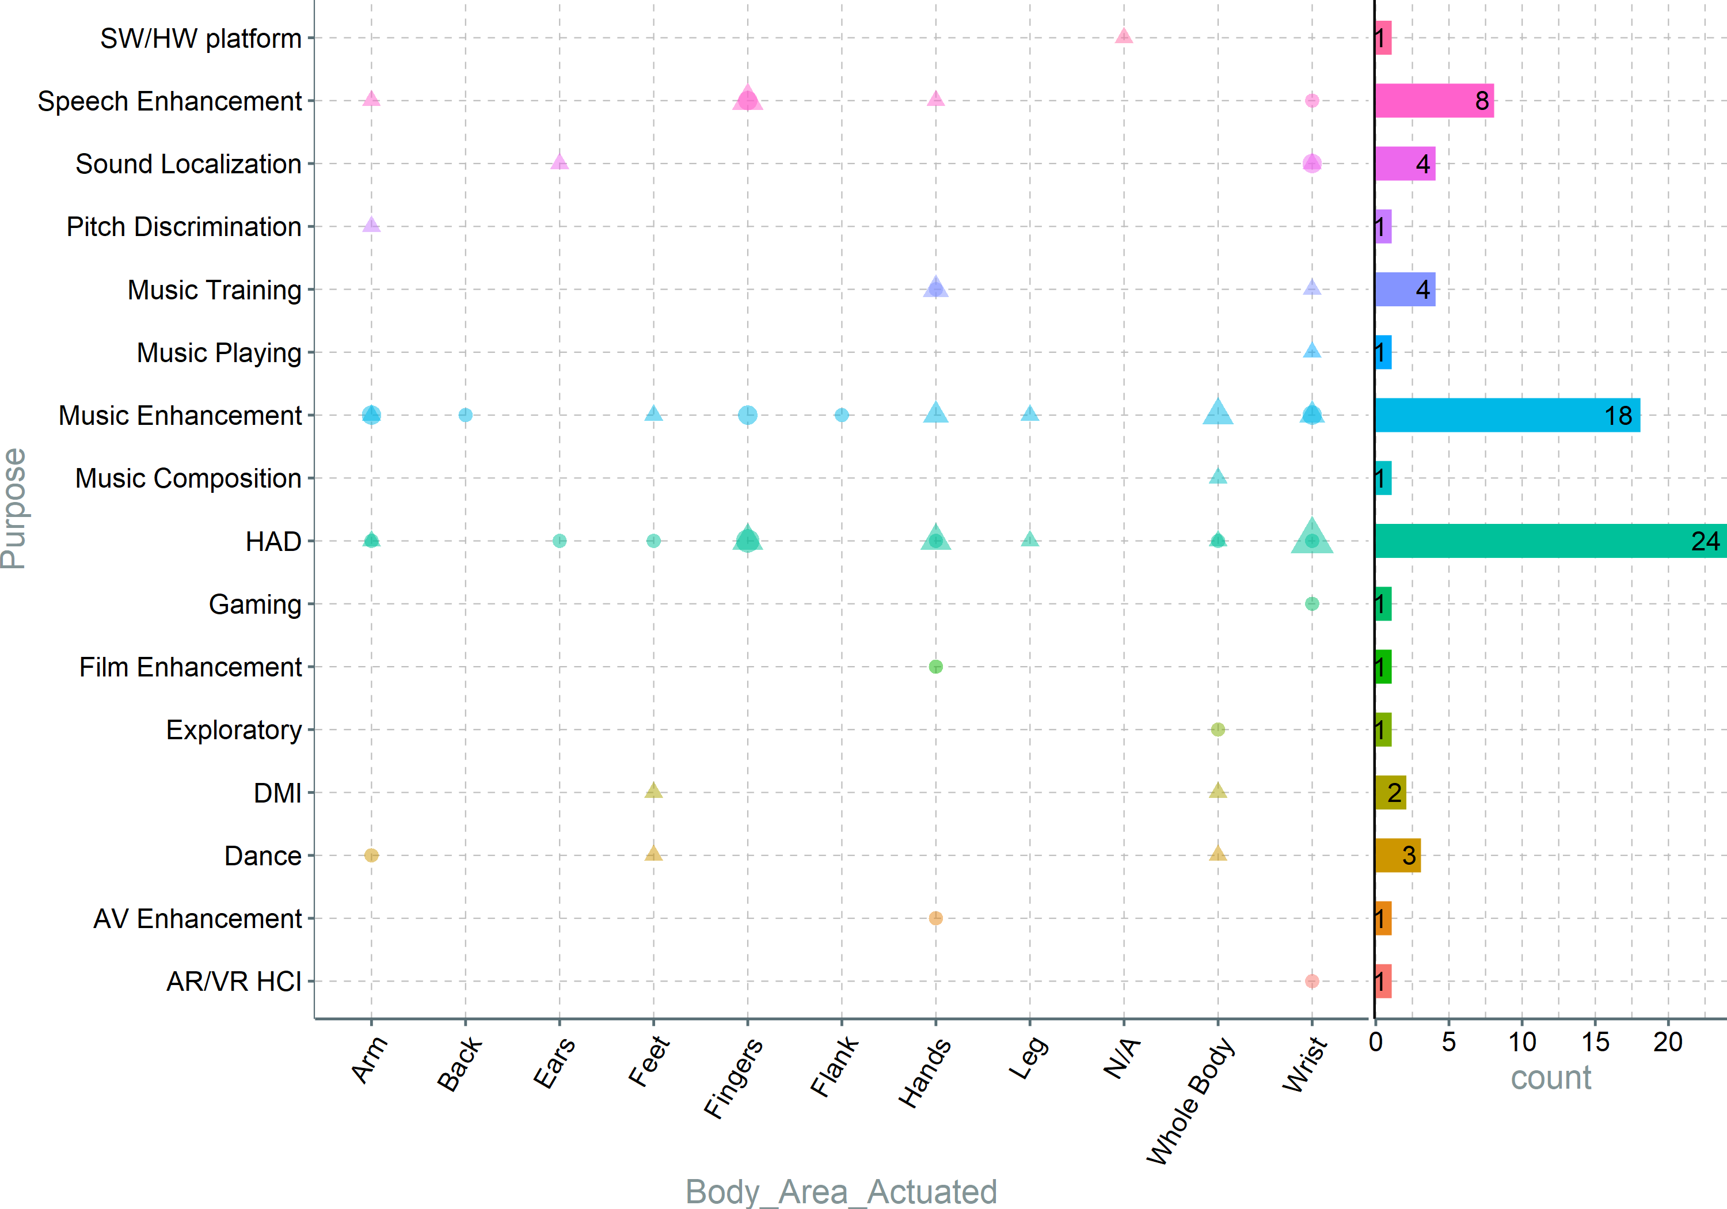
Notes:
Speech enhancement uses only the hand area, as it provides best freq and amplitude discrimination. Feet are only mostly used for music, and the hands(and the area in general) are used for all purposes, further establishing that the hands are most practical. Looking at it differently, it seems like research in Music and HAD has not converged on the optimal solution yet.

Slide 6
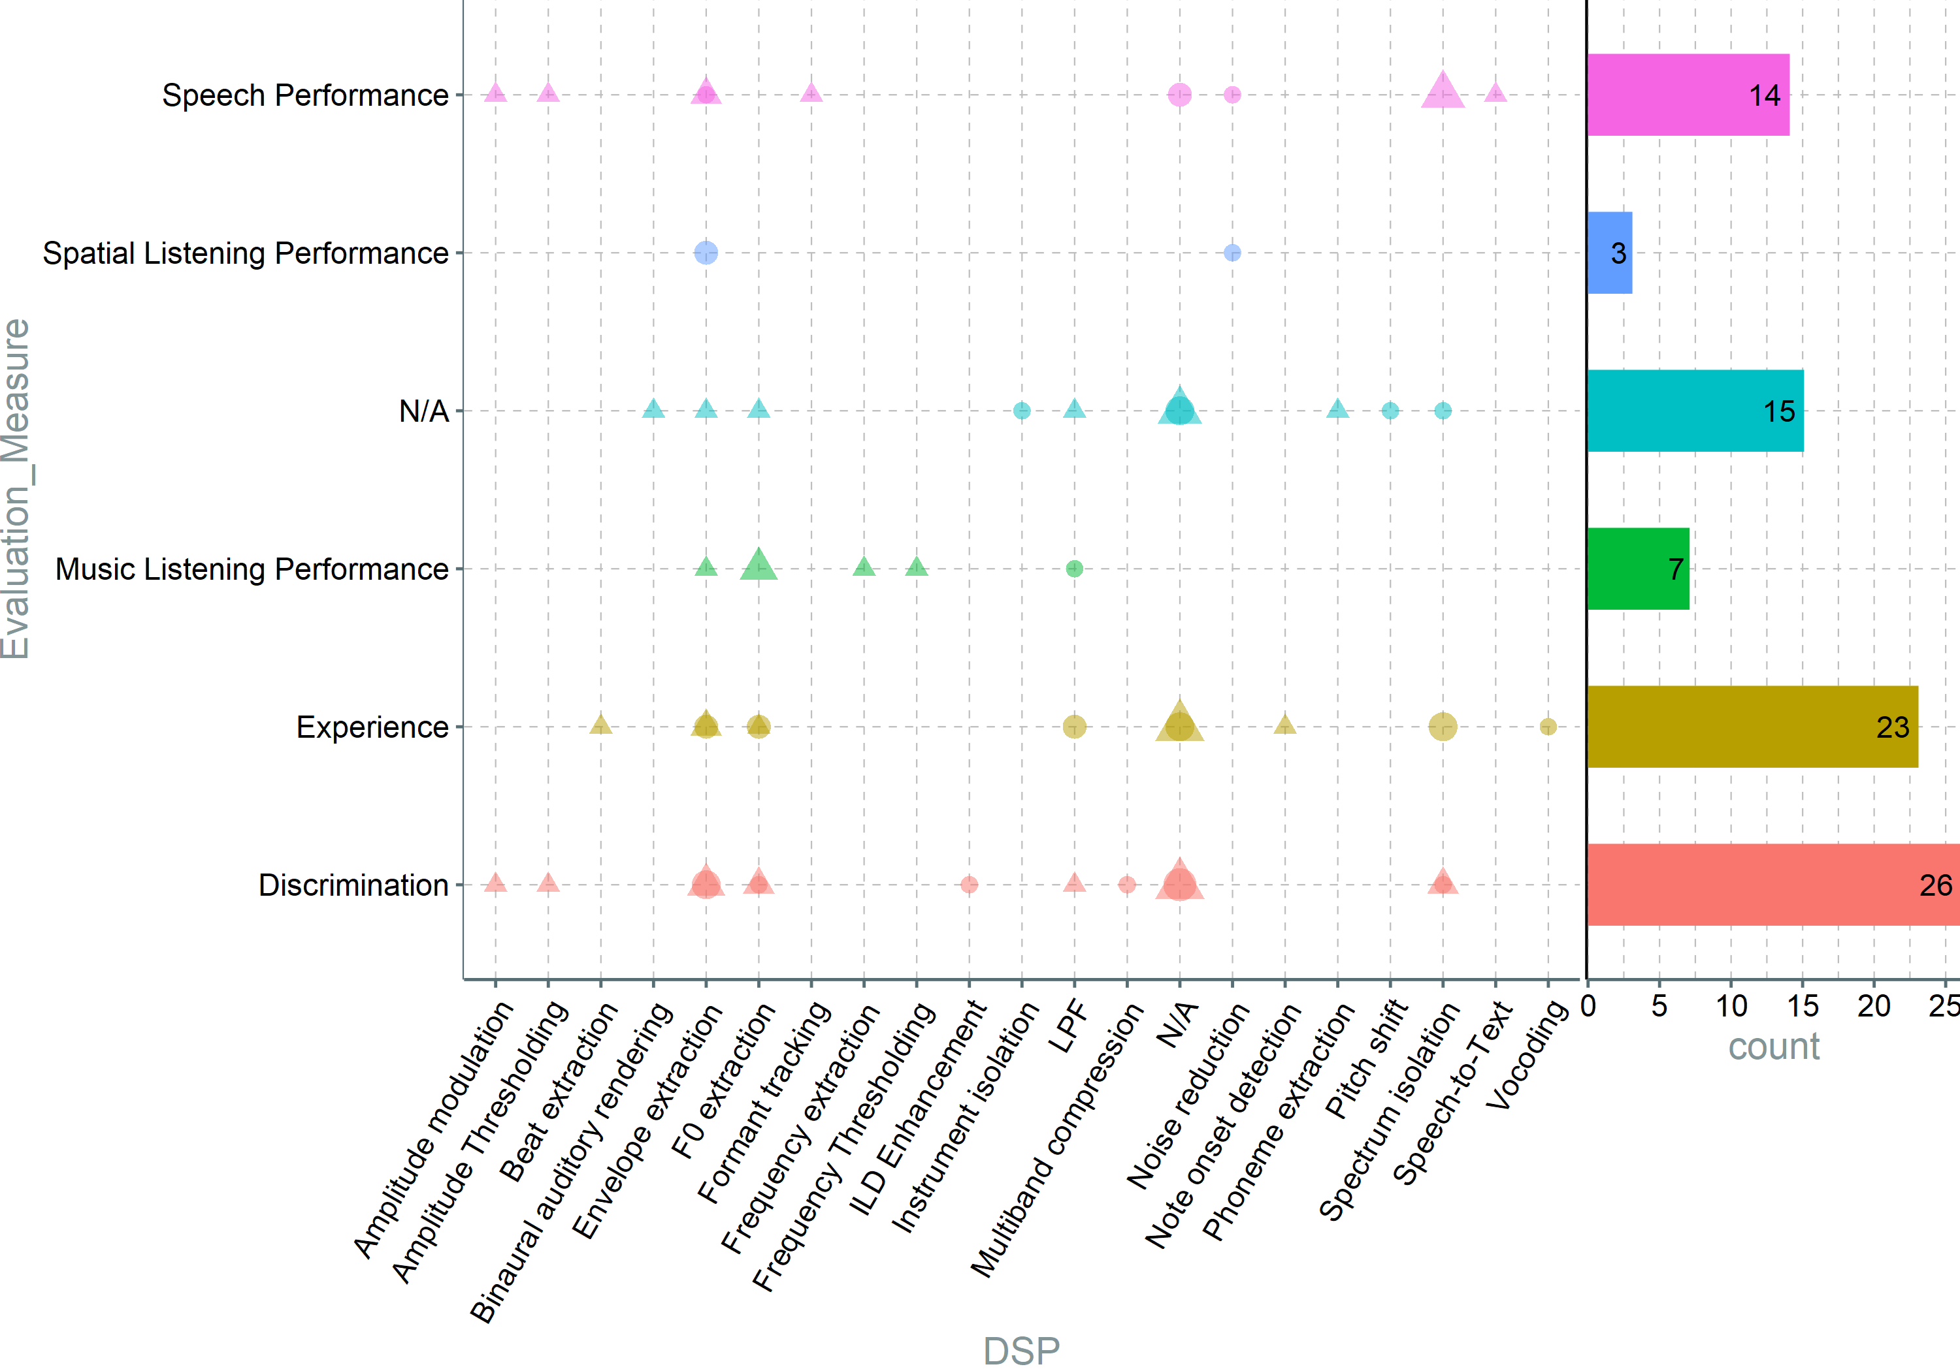
Notes:
I don’t think this pair makes much sense since.

Slide 7
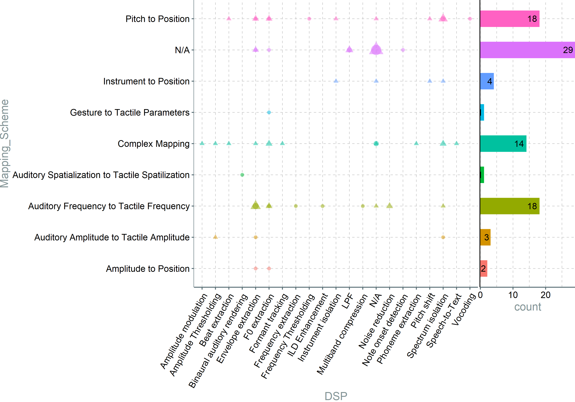
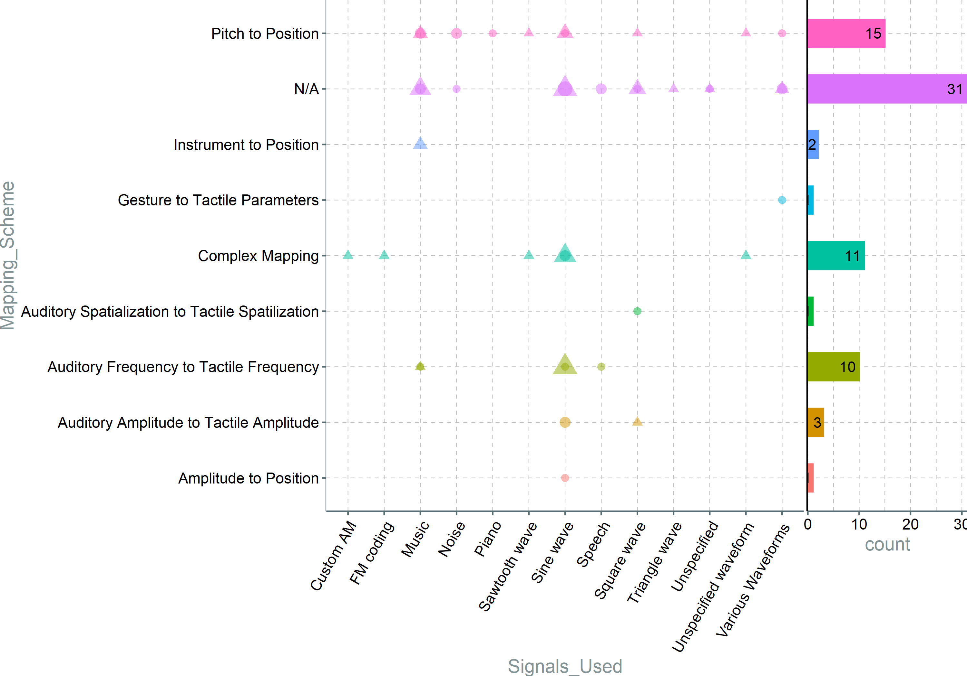
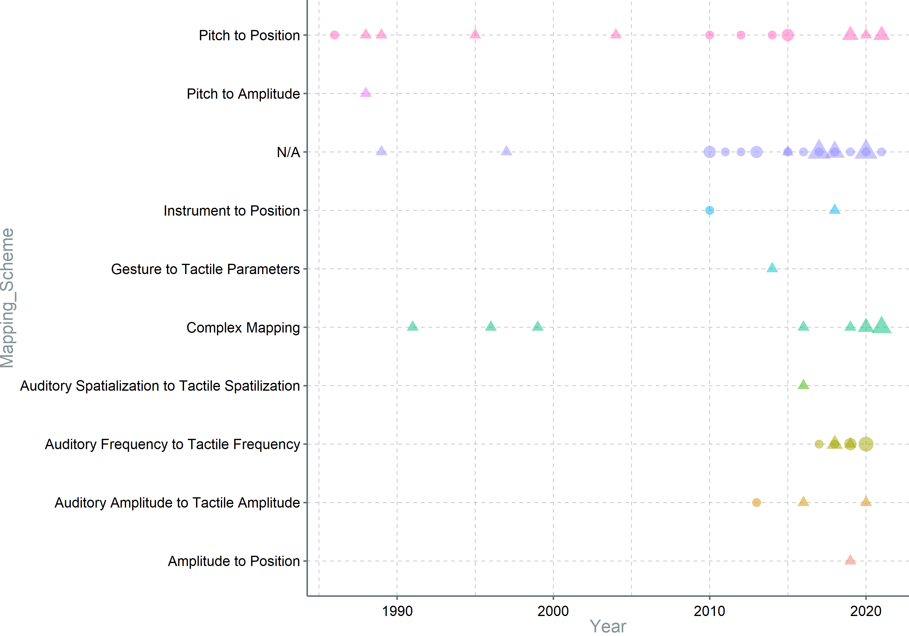
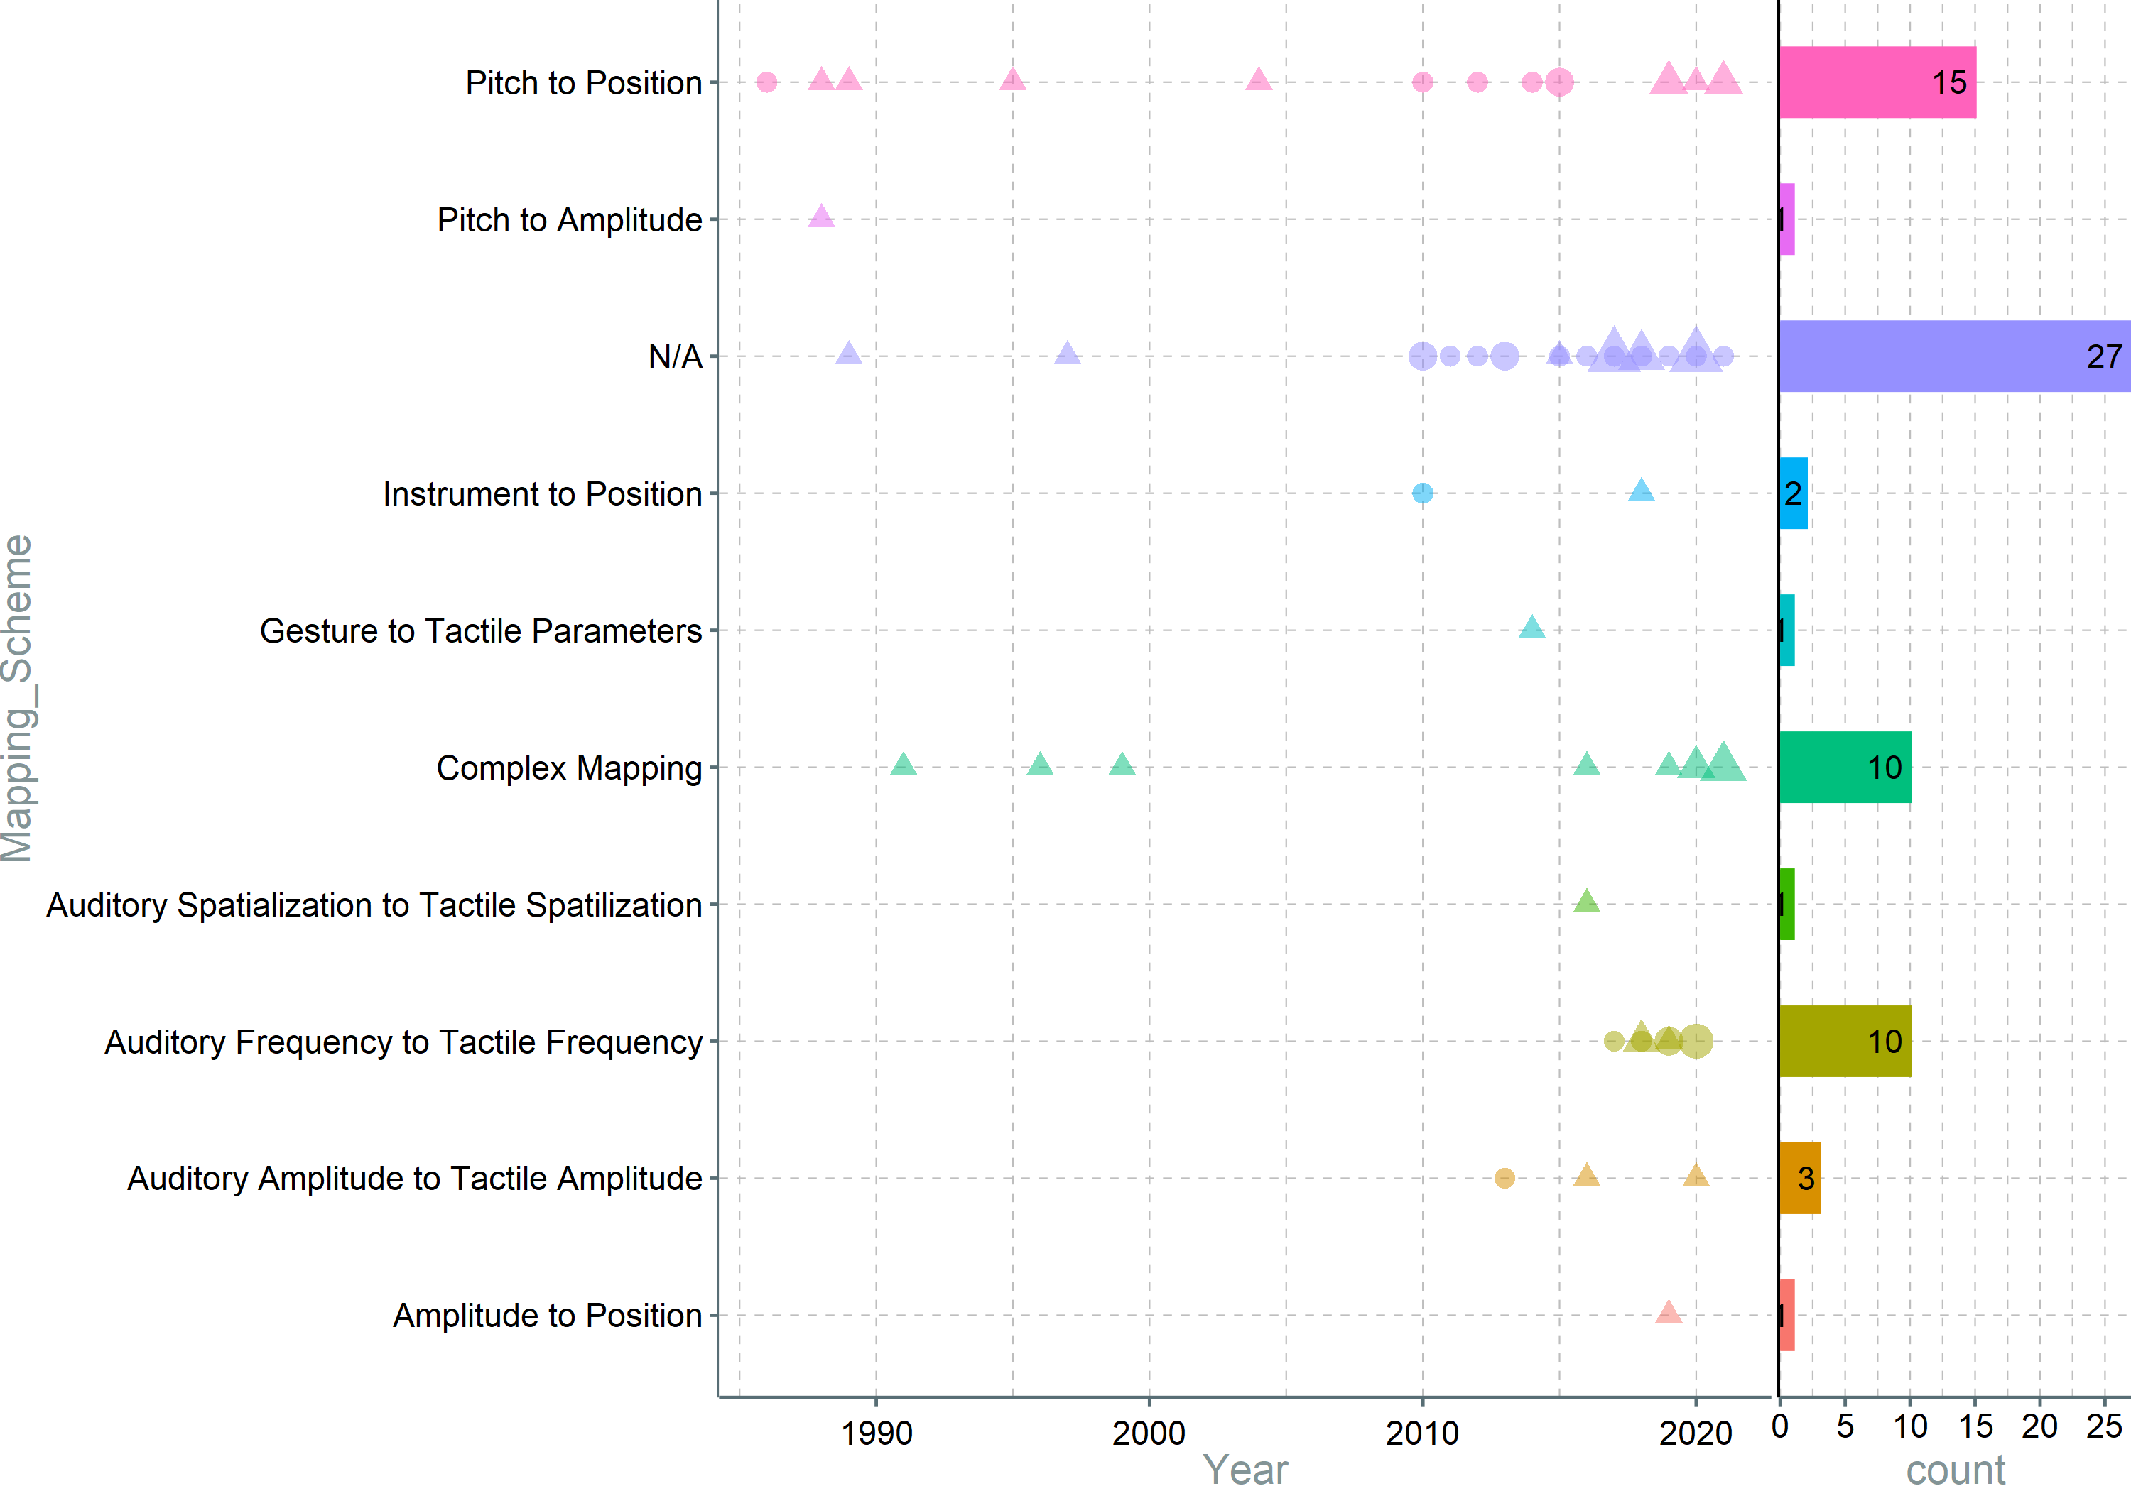
Notes:
LINKED WITH NEXT SLIDE. Again, wrist and fingers are used with mappings that require higher accuracy in terms of frequency, while mappings that rely on simpler encodings (like amplitude and custom encodings), but those are generally used with a higher number of actuators (see next slide); an potential explination for this is that the lower physiological accuracy in certain areas is compensated with a higher number of actuators. Going back to the number of actuators in areas that are using AF to TF, it seems that one or two actuators are enough for this type of mapping.

Slide 8
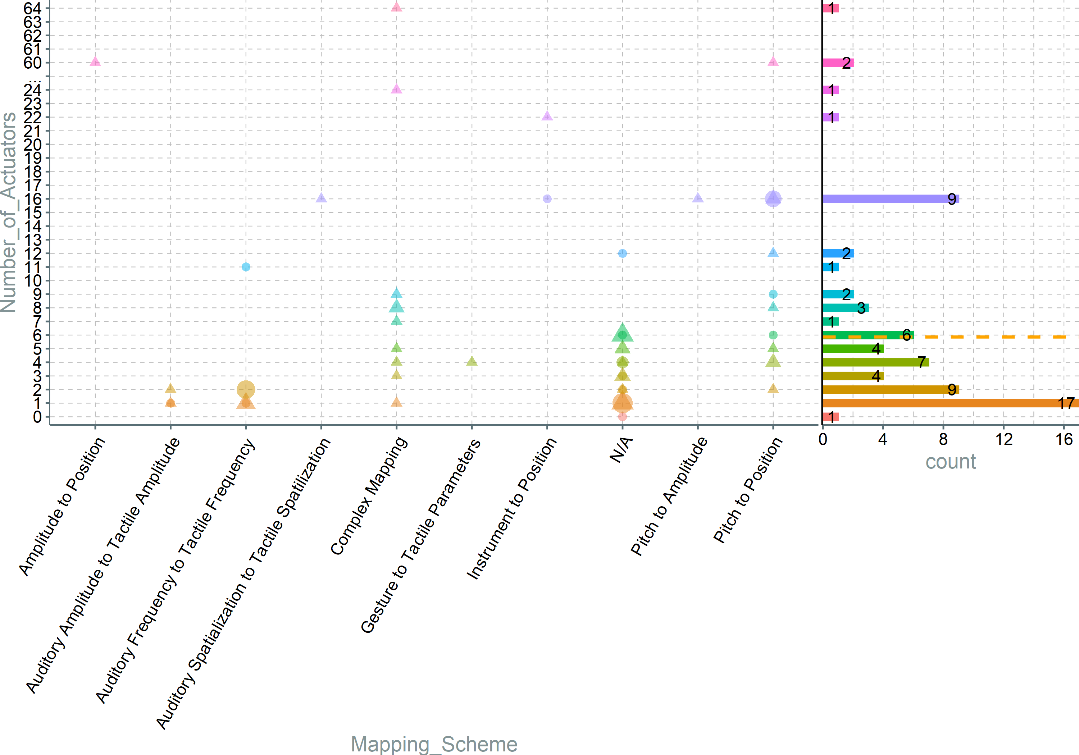
Notes:
LINKED WITH PREVIOUS SLIDE. Besides the fact that only one mapping scheme utilizes tactile frequency, it seems that when it does it’s usually used with a small number of actuators, and as seen before, these actuators are voice coil types. Furthermore, something-to-position mapping is popular, taking advantage of the larger surface area the body can afford. It is worth reminding that, as observed earlier, high sensitivity areas are excited with a small number of actuators, probably constrained by the actuator size.

Slide 9
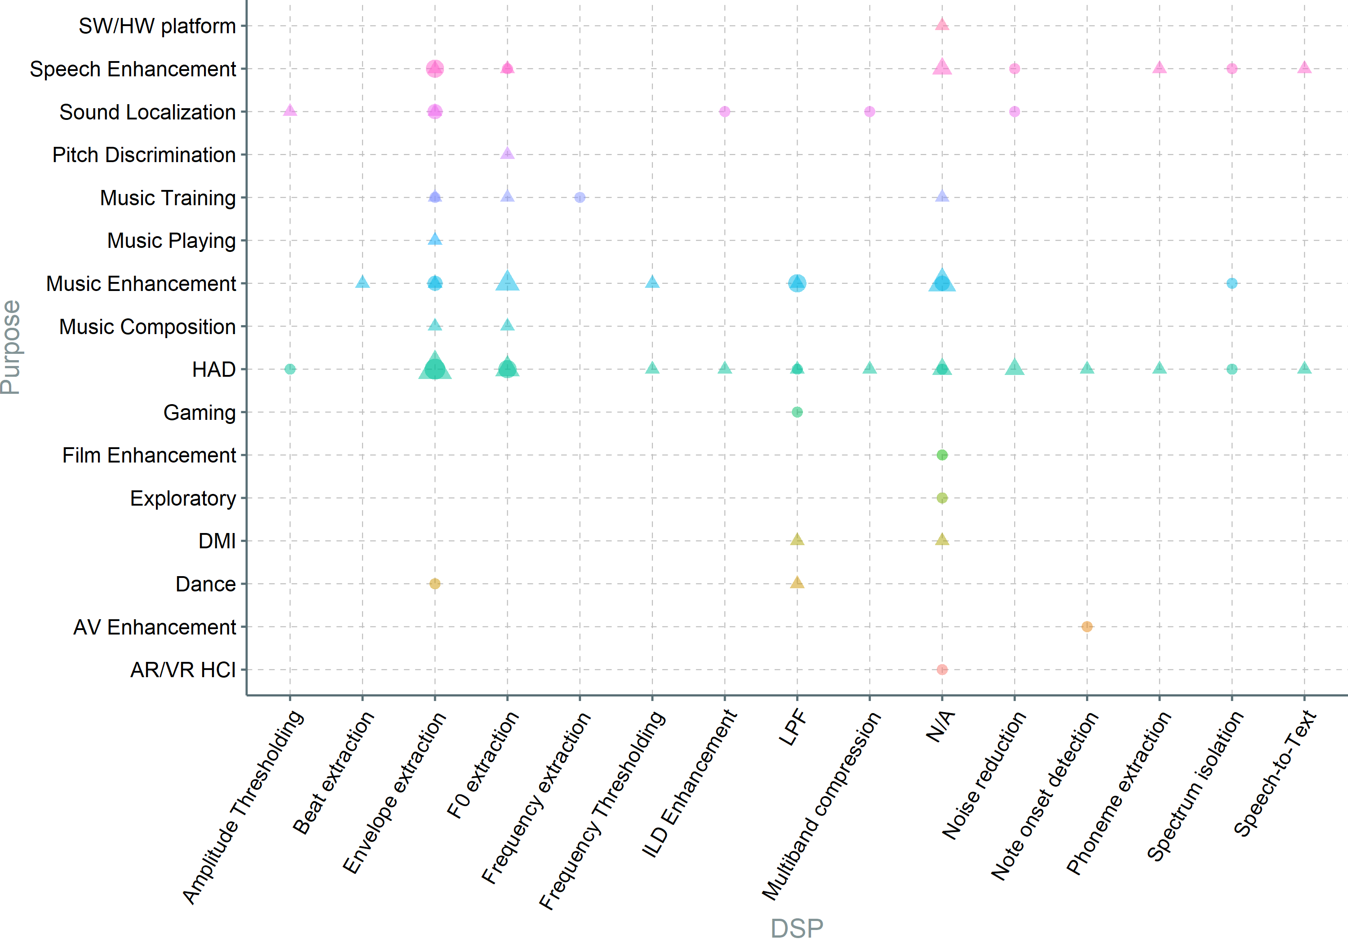
Notes:
Envelope and fundamental extraction are mostly used for Music and Speach, and not so much for other entertainment purposes where sound can be in a secondary role.

Slide 10
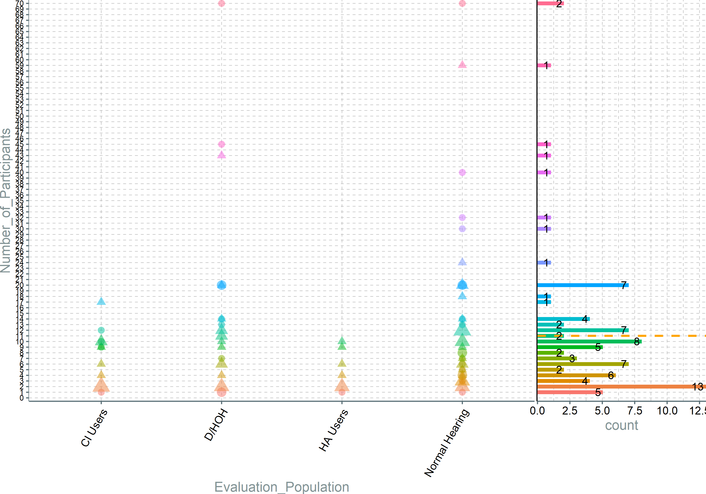
Notes:
Obviously the overall number of participants is very small, with the mean of 11 (orange Dashed Line), resulting in generally low reliability studies. On top of that we can see that even HA and CI users studies are mostly below this average. This is a strong indicator that most of the research is preliminary and underlines the necessity for studies adhering to clinical guidelines (longitudinal, more participants, better control).

Slide 11
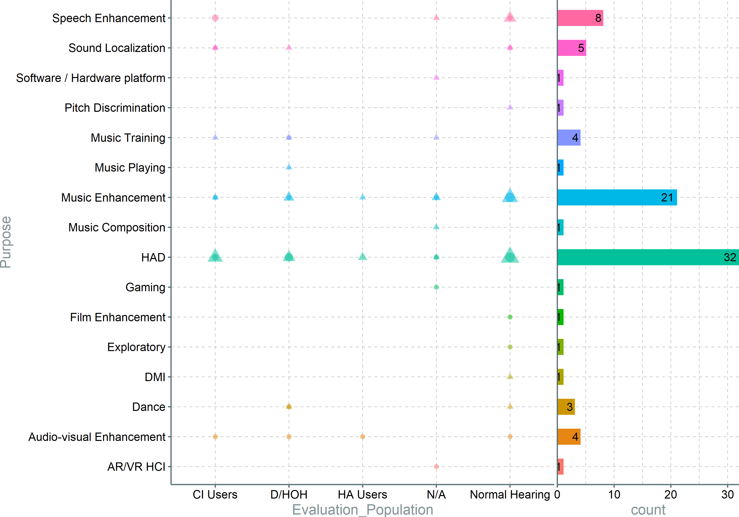
Notes:
CI users are mostly evaluating systems focusing on music and speech, while HA users only focus on music. This could be explained by the fact that the speech needs for HA users are fulfilled by the current state of the art, in HA tech. On the other hand, it could be argued that tactile augmentation could be interesting for normal hearing individuals as well; this can be seen in the push for "4d, 6d, nD," cinema experiences. Nevertheless, it cannot be overlooked that devices aiming groups with particular set of requirements (CI and HA users) are evaluated using normal hearig population, sometimes exclusively. This practice, while common, might result in studies with a lower validity, due to the fact that the requirements for the target population are not met.

Slide 12
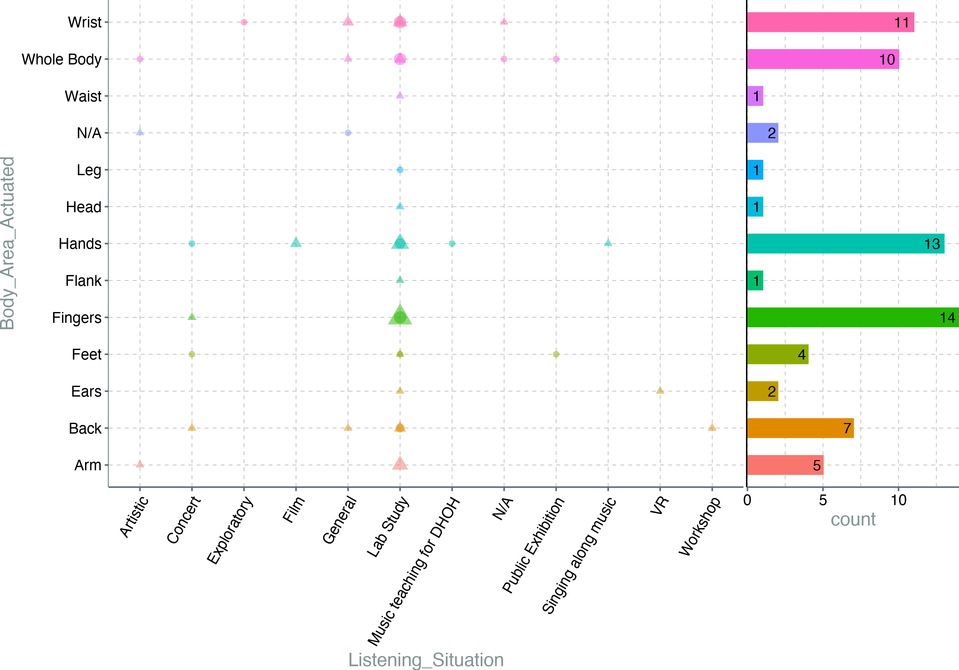
Notes:
The hand area is taking 11(wrist) + 13(hands) + 14(fingers) = 38/72 = 53%; if arm is included as well, it adds up to 43/72 = 60%. This is in line with the previously presented graphs(make sure the order is still the same), that emphasize the importance of hands as most sensitive body areas, while at the same time they allow for a great deal of flexibility in terms of fittings and actuator sizes. Furthermore t is obvious that the most commonly listening purpose is lab studies, cementing the hypothesis that the studies are preliminary, and larger and more ecological studies are necessary in order to transition the technology from labs to industry.

Slide 13
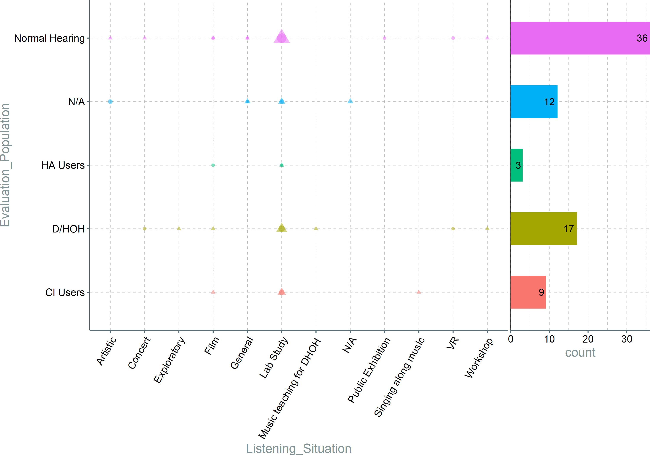
Notes:
Besides the aforementioned majority of study being done on normal hearing individuals, it's observable that HADs are still mostly evaluated in labs, and not so much in the "real world". Contrary application that are evaluated by normal hearing individuals, have diverse listening situations.

Slide 14
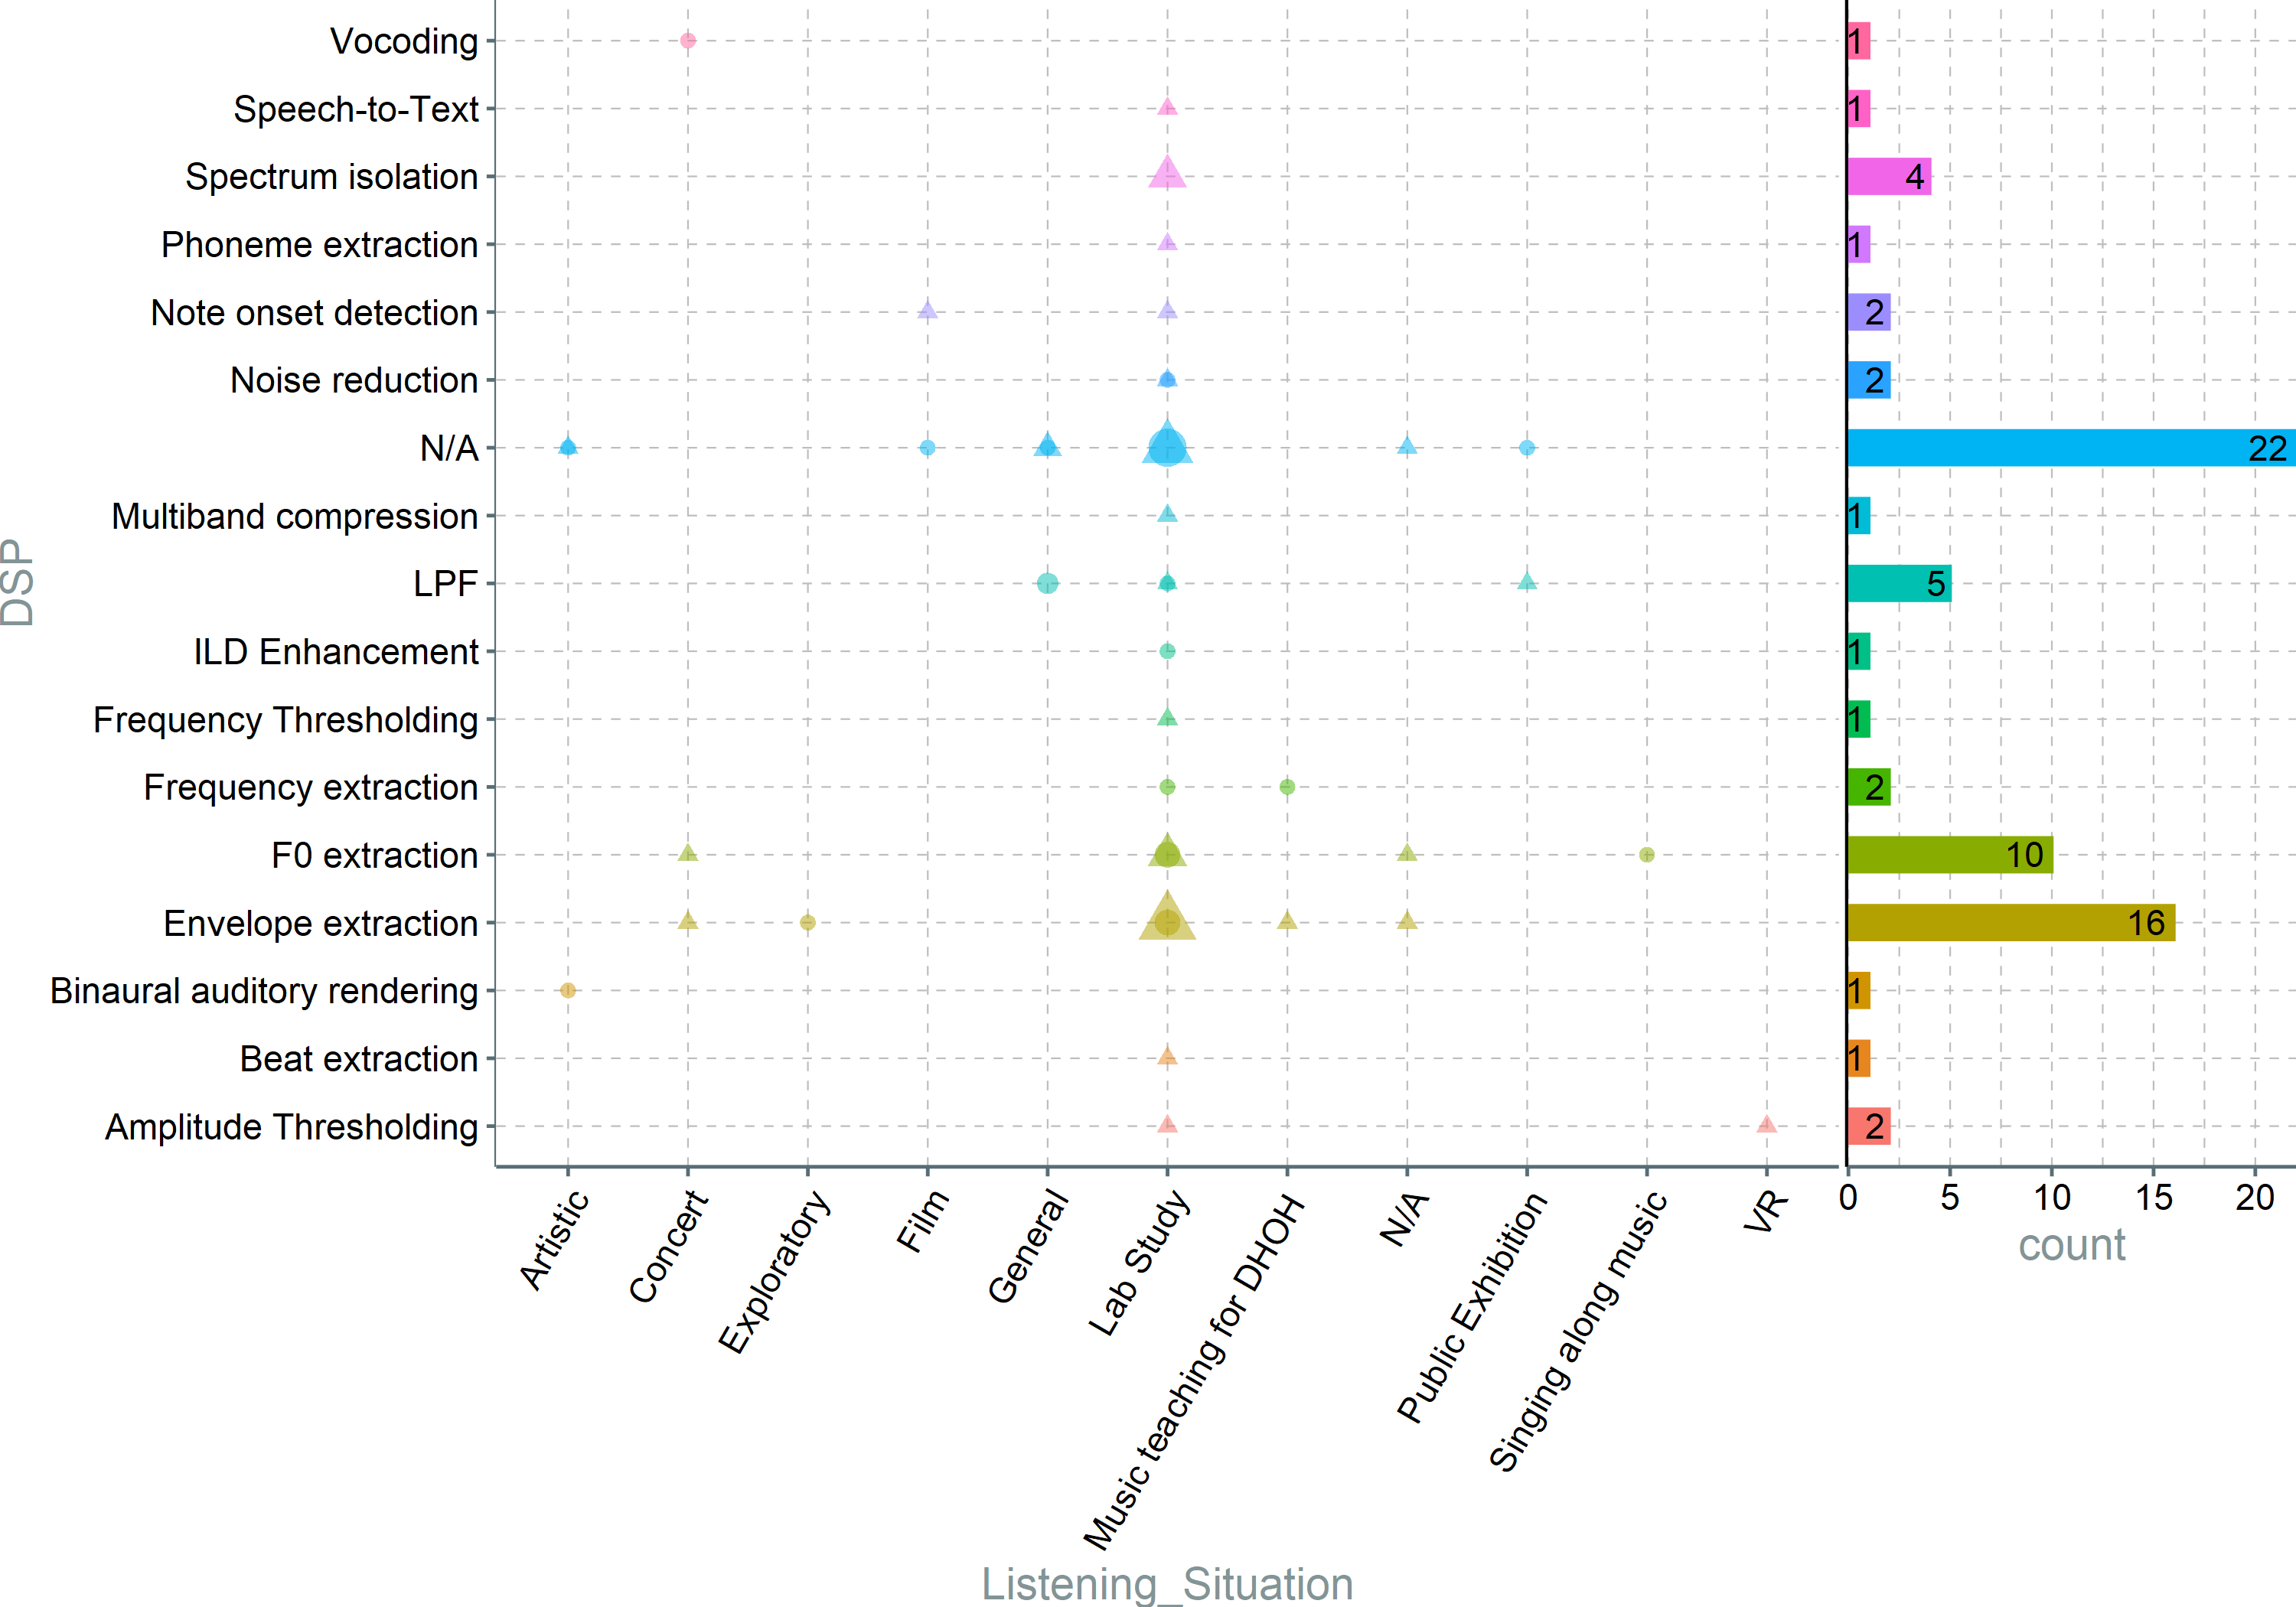
Notes:
The majority of DSPs are used exclusively in lab studies. Besides that, a large amount of systems don't use any processing at all. This could indicate that the researchers did not manage to convince their peers about the optimal sound processing methods.

Slide 15
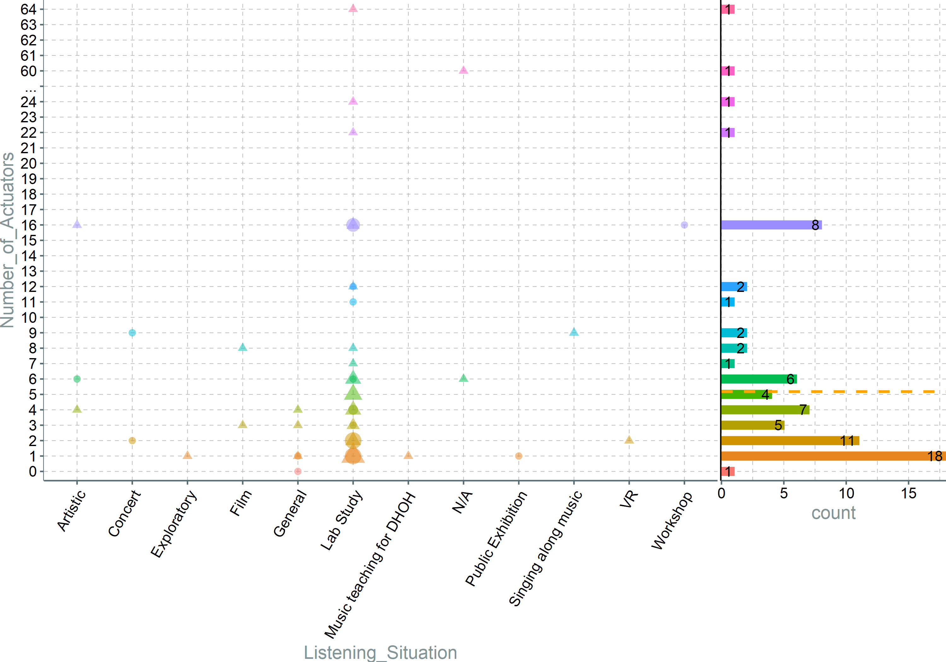
Notes:
Main conclusion here would be that there is no consensus regarding the optimal number of actuators, and researches are experimenting with systems of various sizes and DSPs.

Slide 16
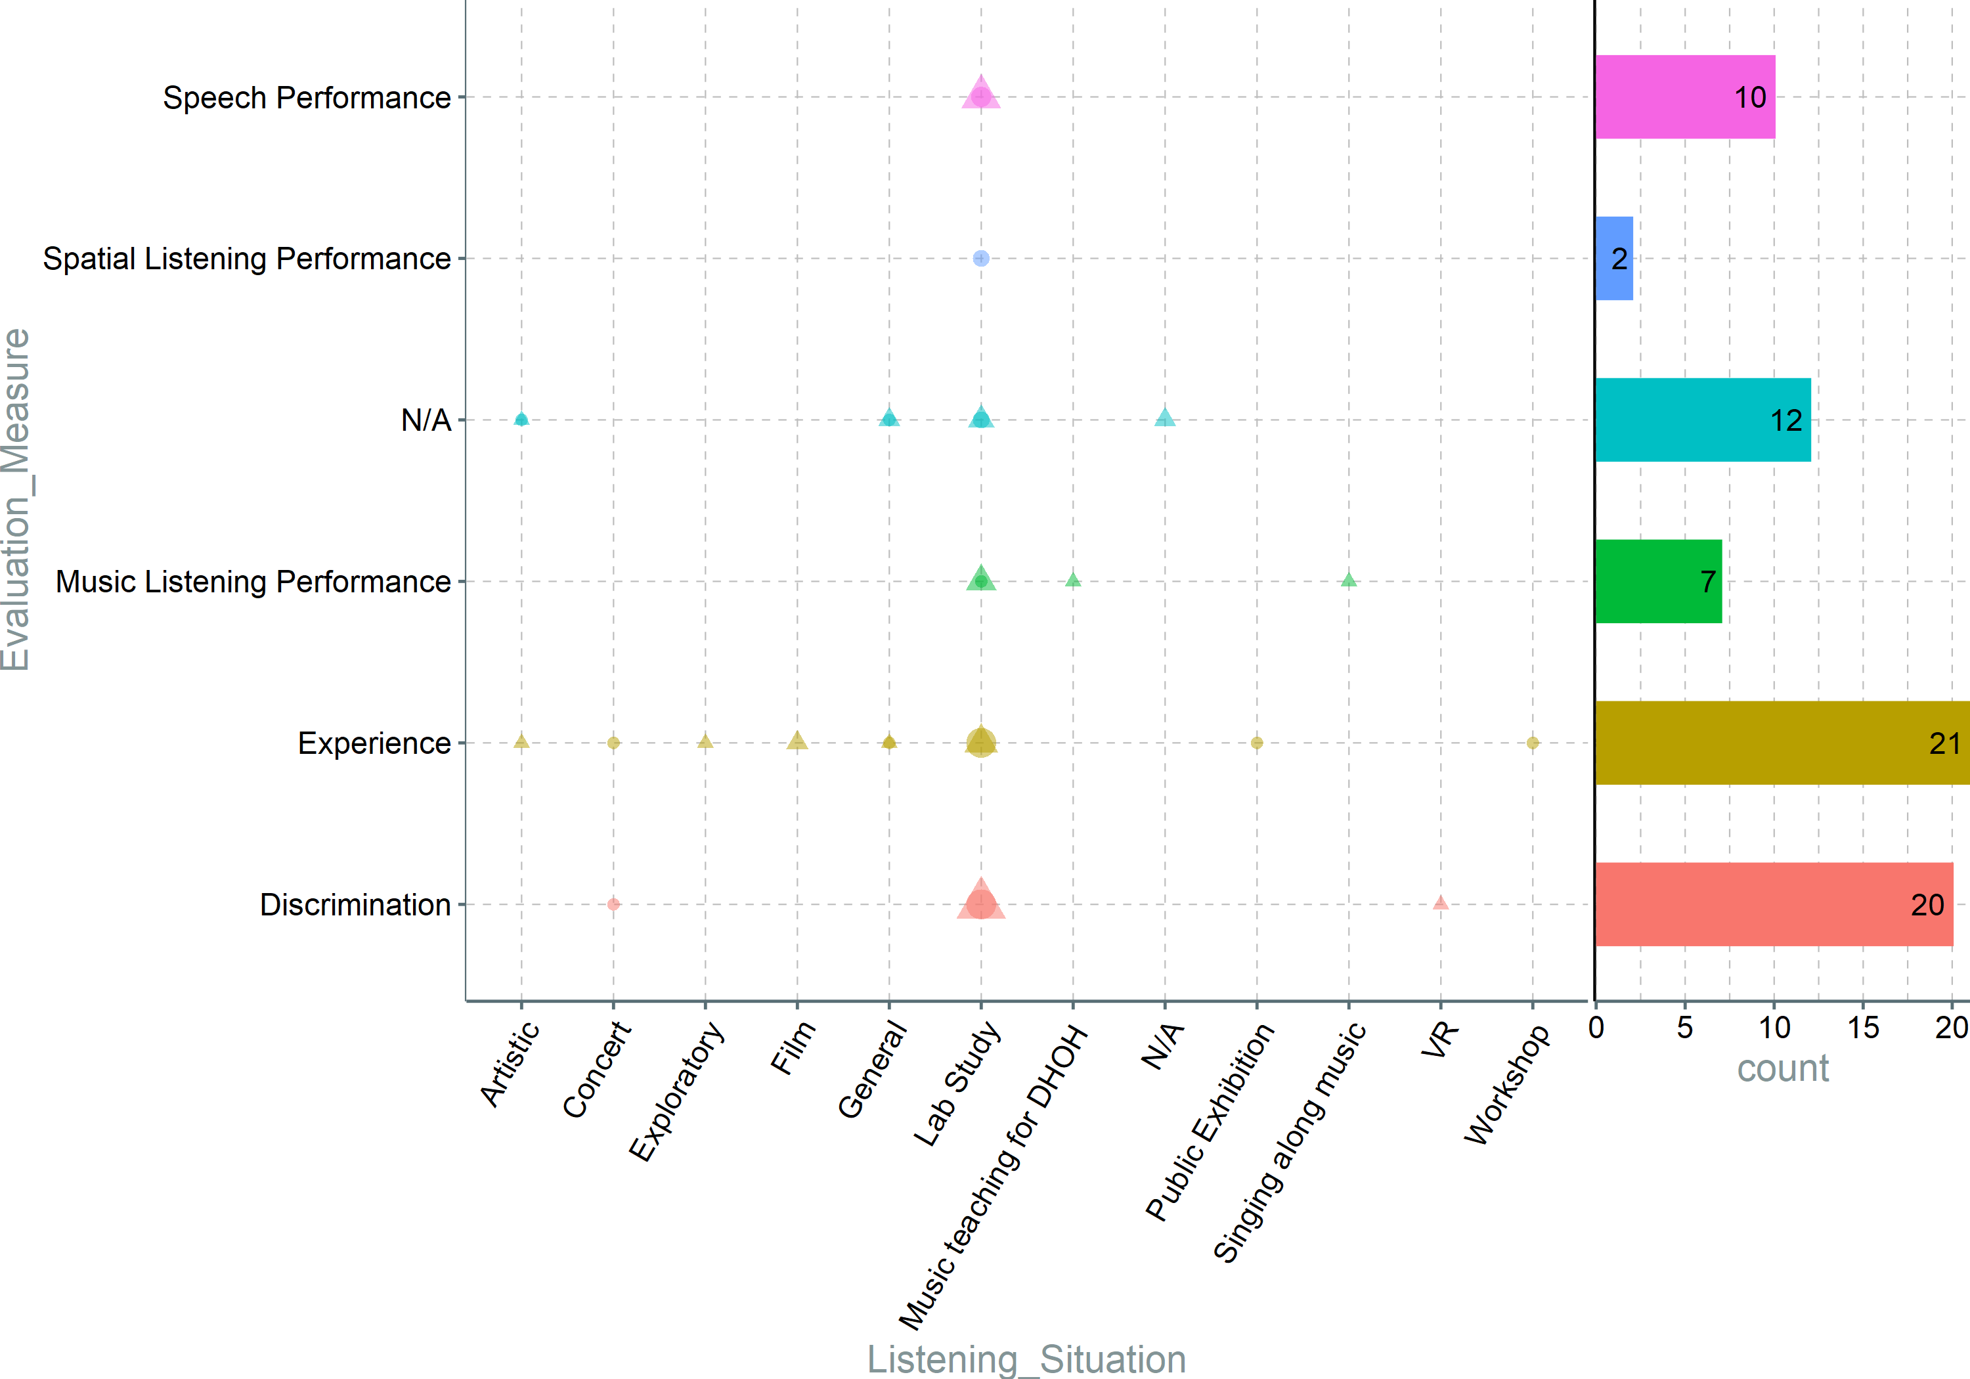
Notes:
On one side, the large number of discrimination studies further highlight the incipient state of the research field, which looks to outline the "playing field" by testing threshold and JNDs. On the other side, studies focusing on Speech and Music performance combined are almost as frequent, indicating that researchers bring forward new systems and ideas that have a more applied research angle to them. This aspect is supported as well by the large emphasis on the users' experience, that is evaluated in various listening situations, not only in research labs.

Slide 17
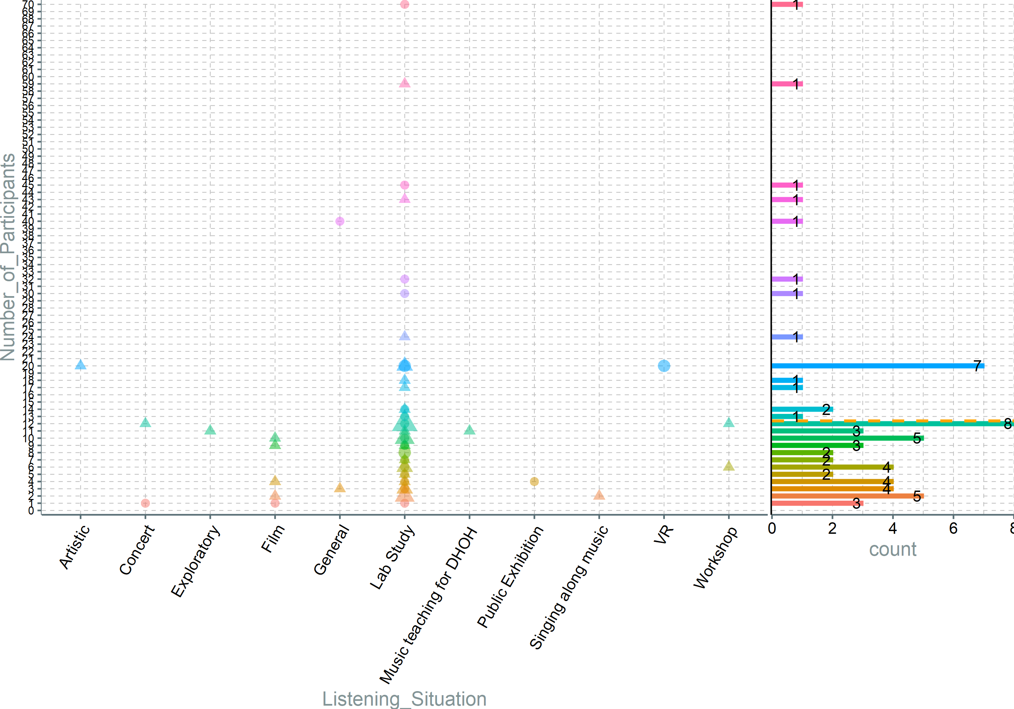
Notes:
Lab studies have a very variate nr of participants, probably because of different stages where target systems are evaluated. (kind of obvious, and not much else interesting).

Slide 18
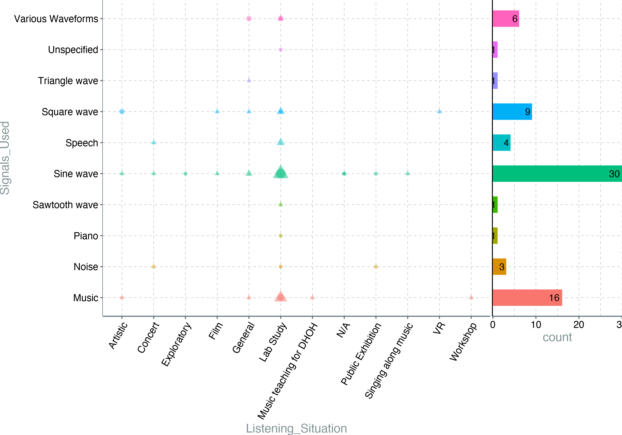
Notes:
This would have been interesting if one listening situation would predominantly use one type of signals.... but not really.

Slide 19
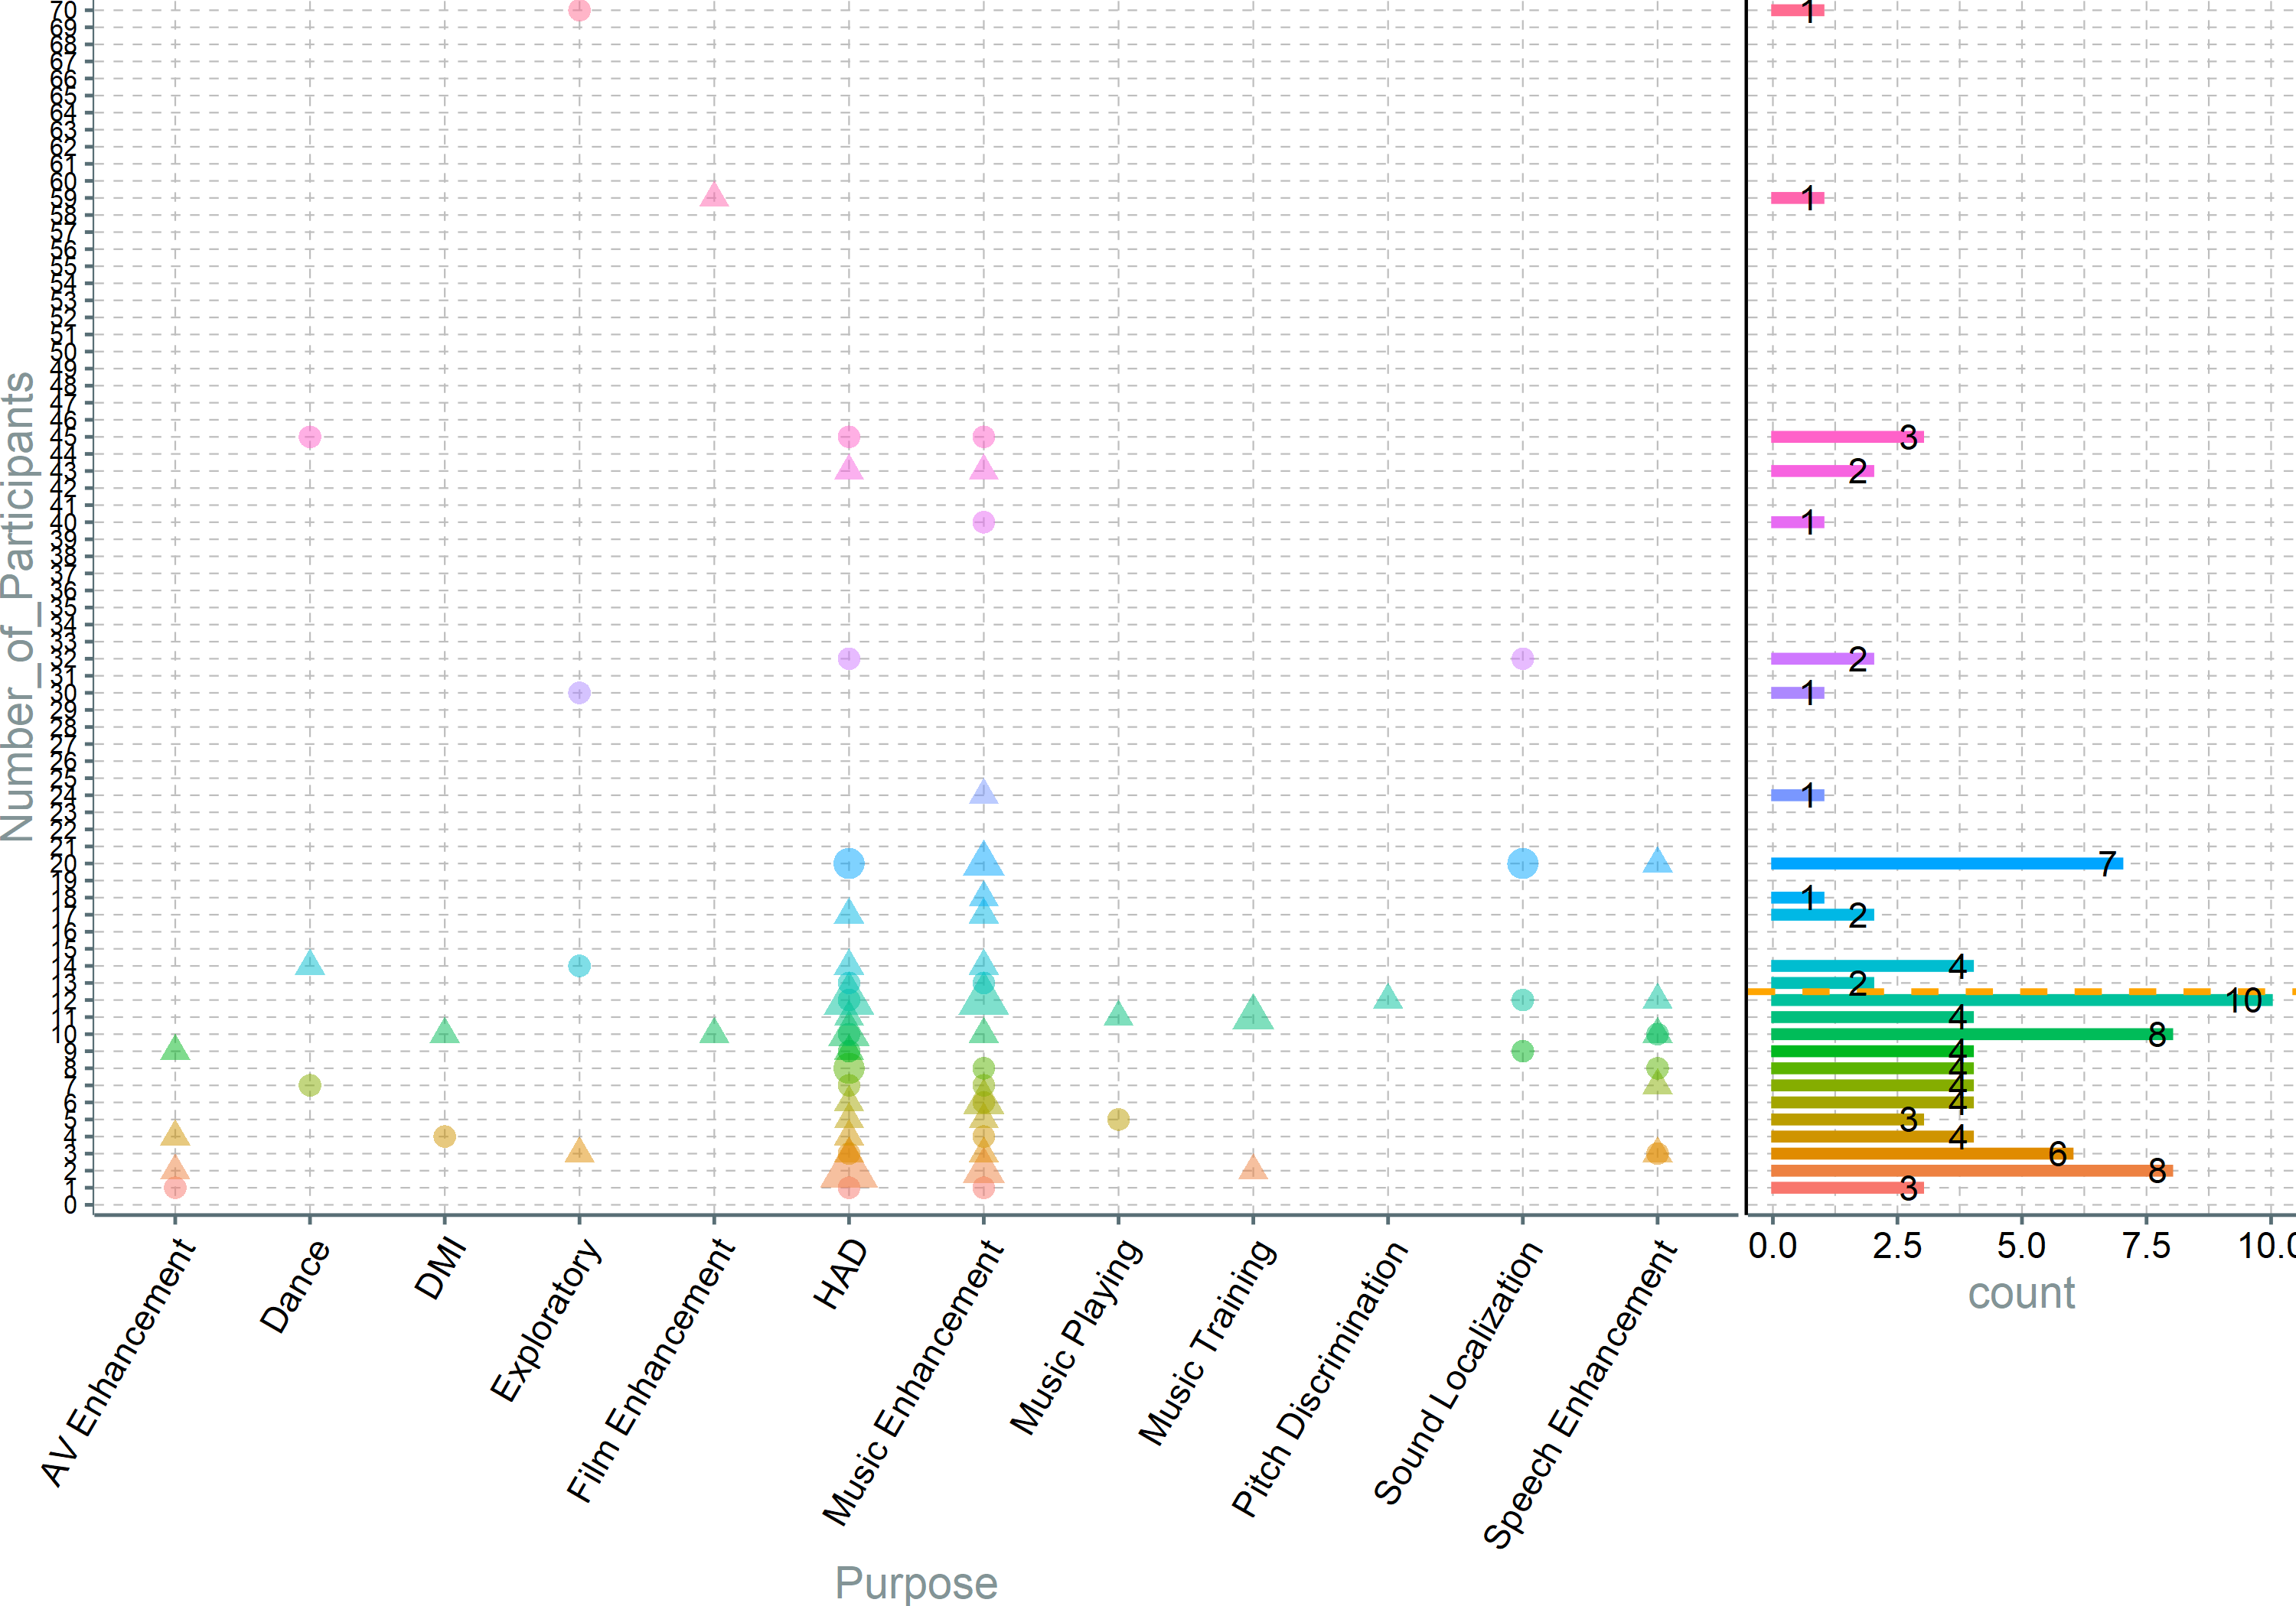
Notes:
No purpose has outlining number of participants (except the two really high numbers). Most of them are on or below average.

Slide 20
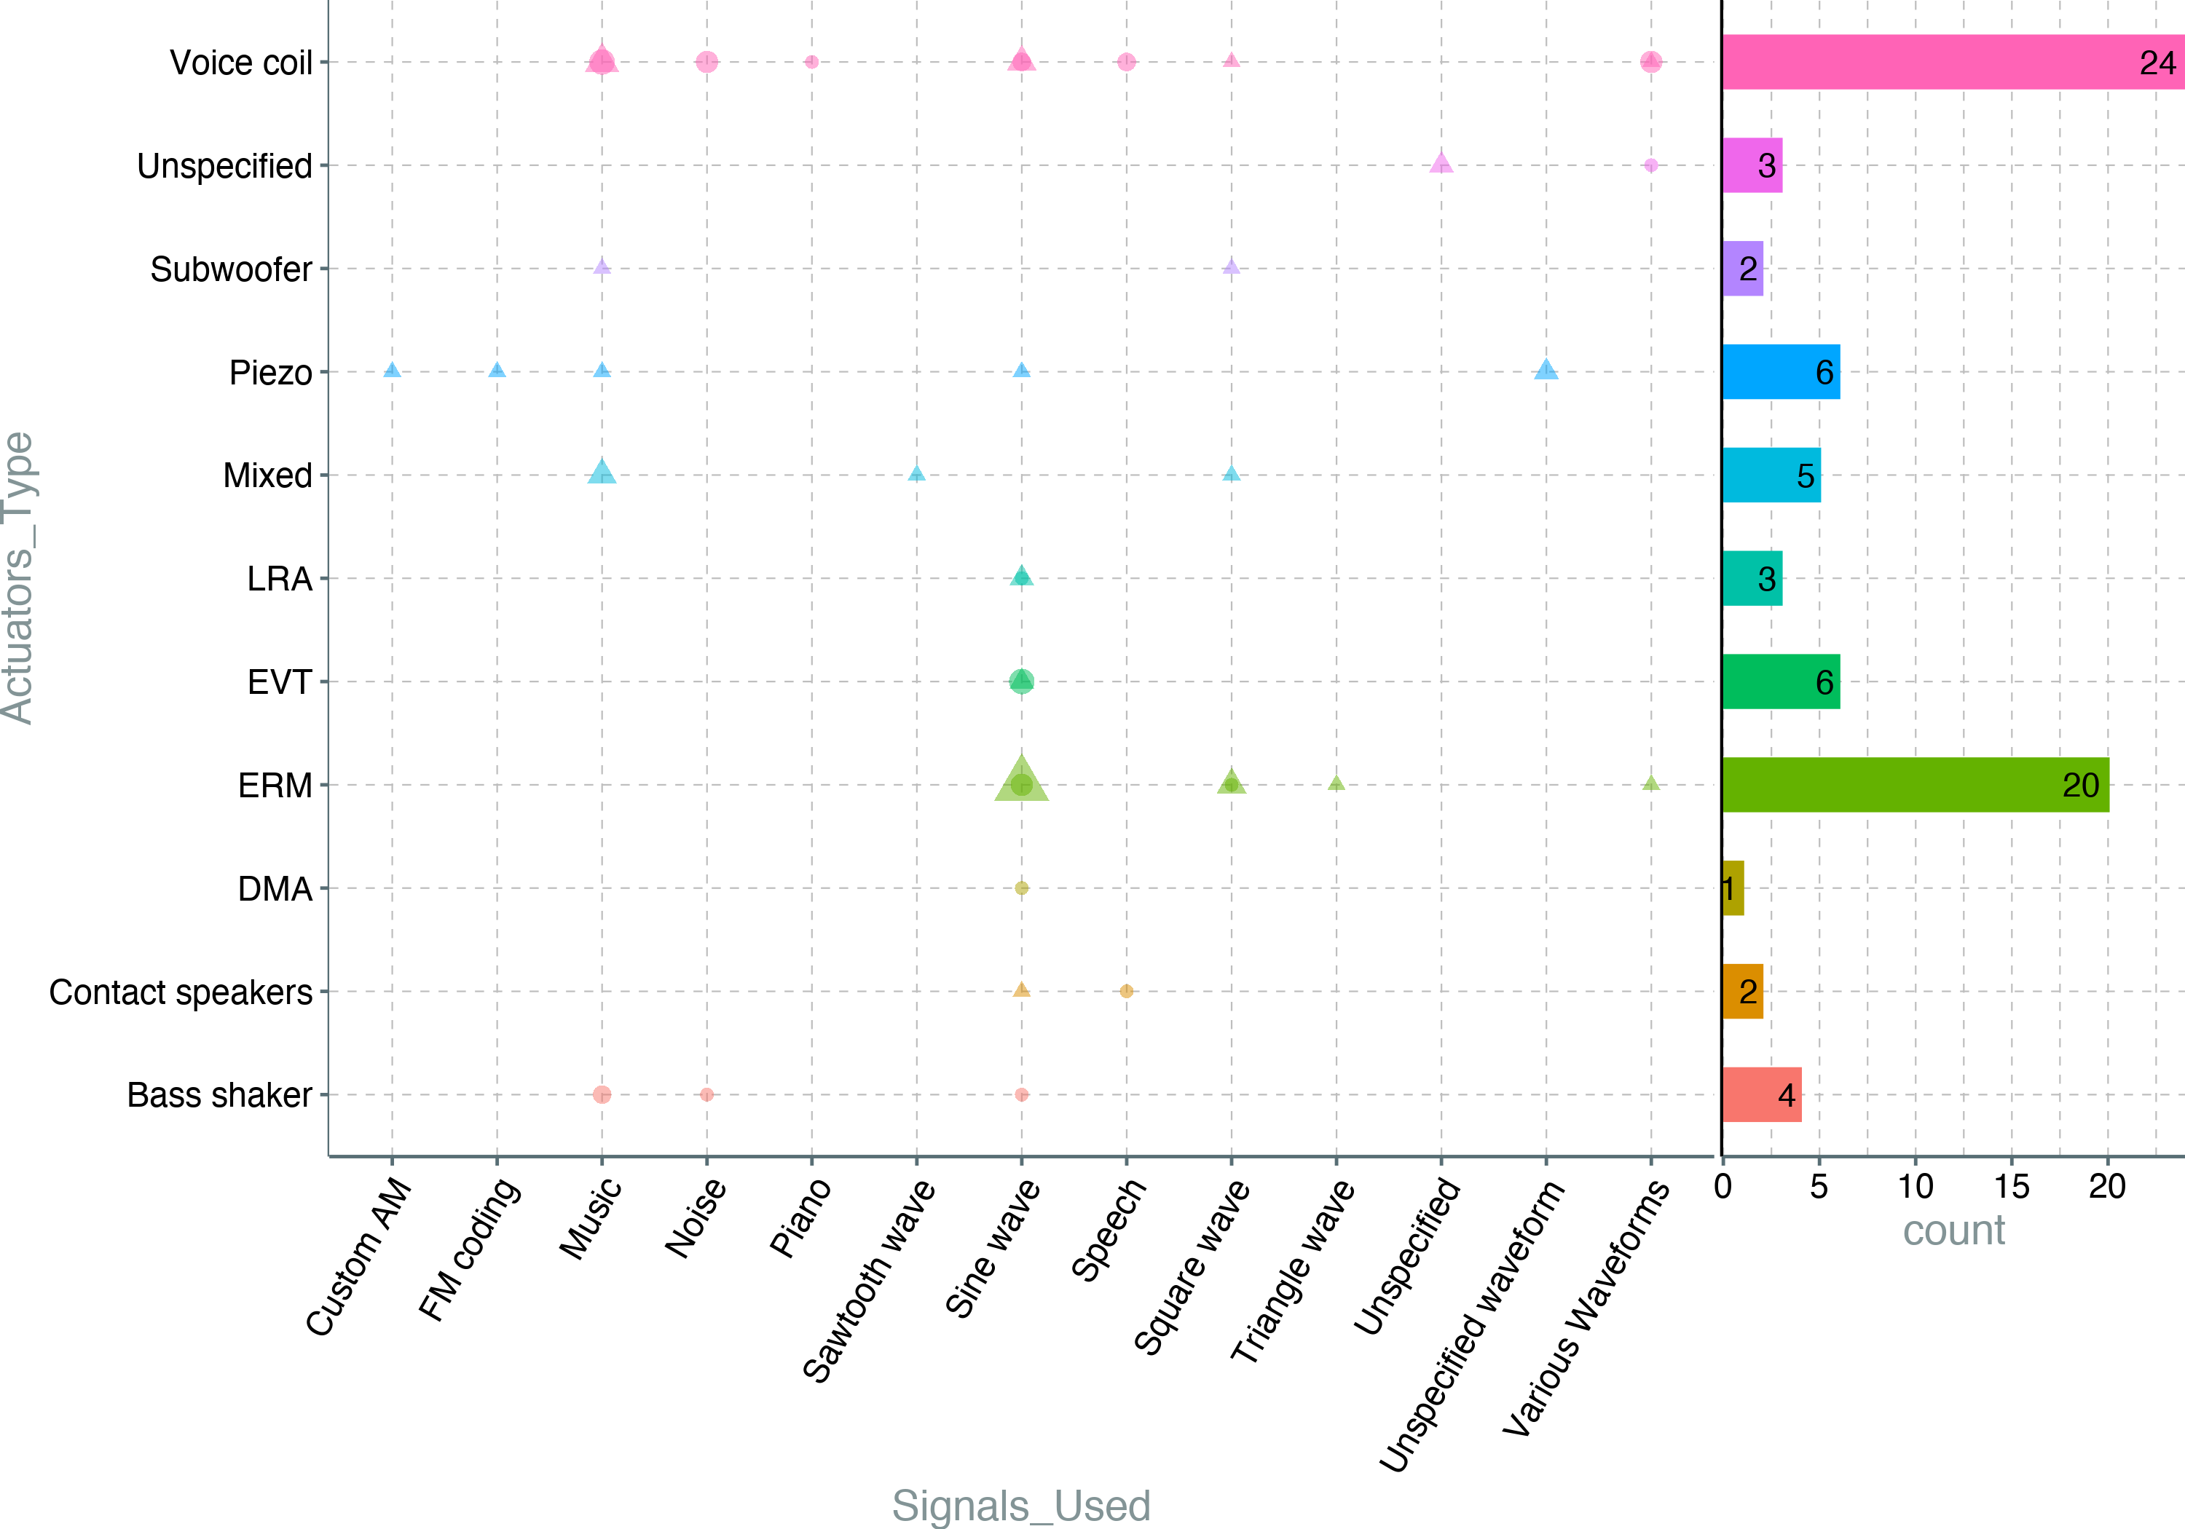
Notes:
It can be observed that researchers use voice coils with a plethora of signals, while ERMs are mostly used as traditionally intended, generating sine waves. Some application use different signals for ERMs, feeding them with different waveforms. This require a different type of convertors(assuming that the signal source is digital), similar to ones provided by Syntacts. Furthermore, it seems that combining actuators are used when harmonically rich experiences are desired.

Slide 21
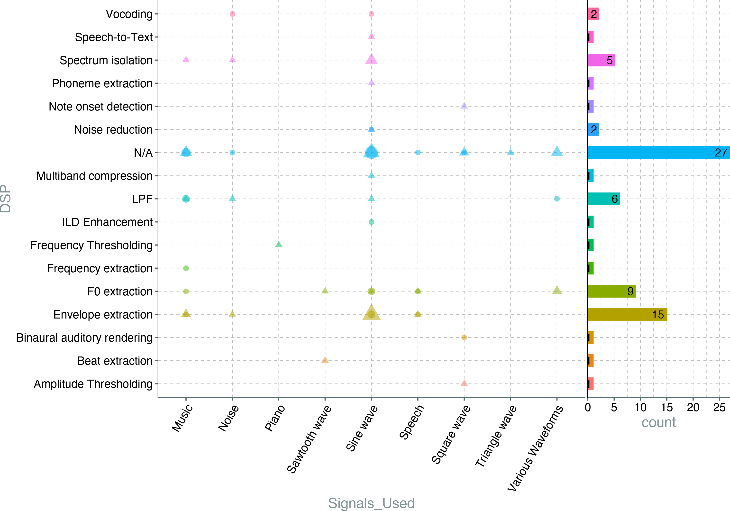

Slide 22
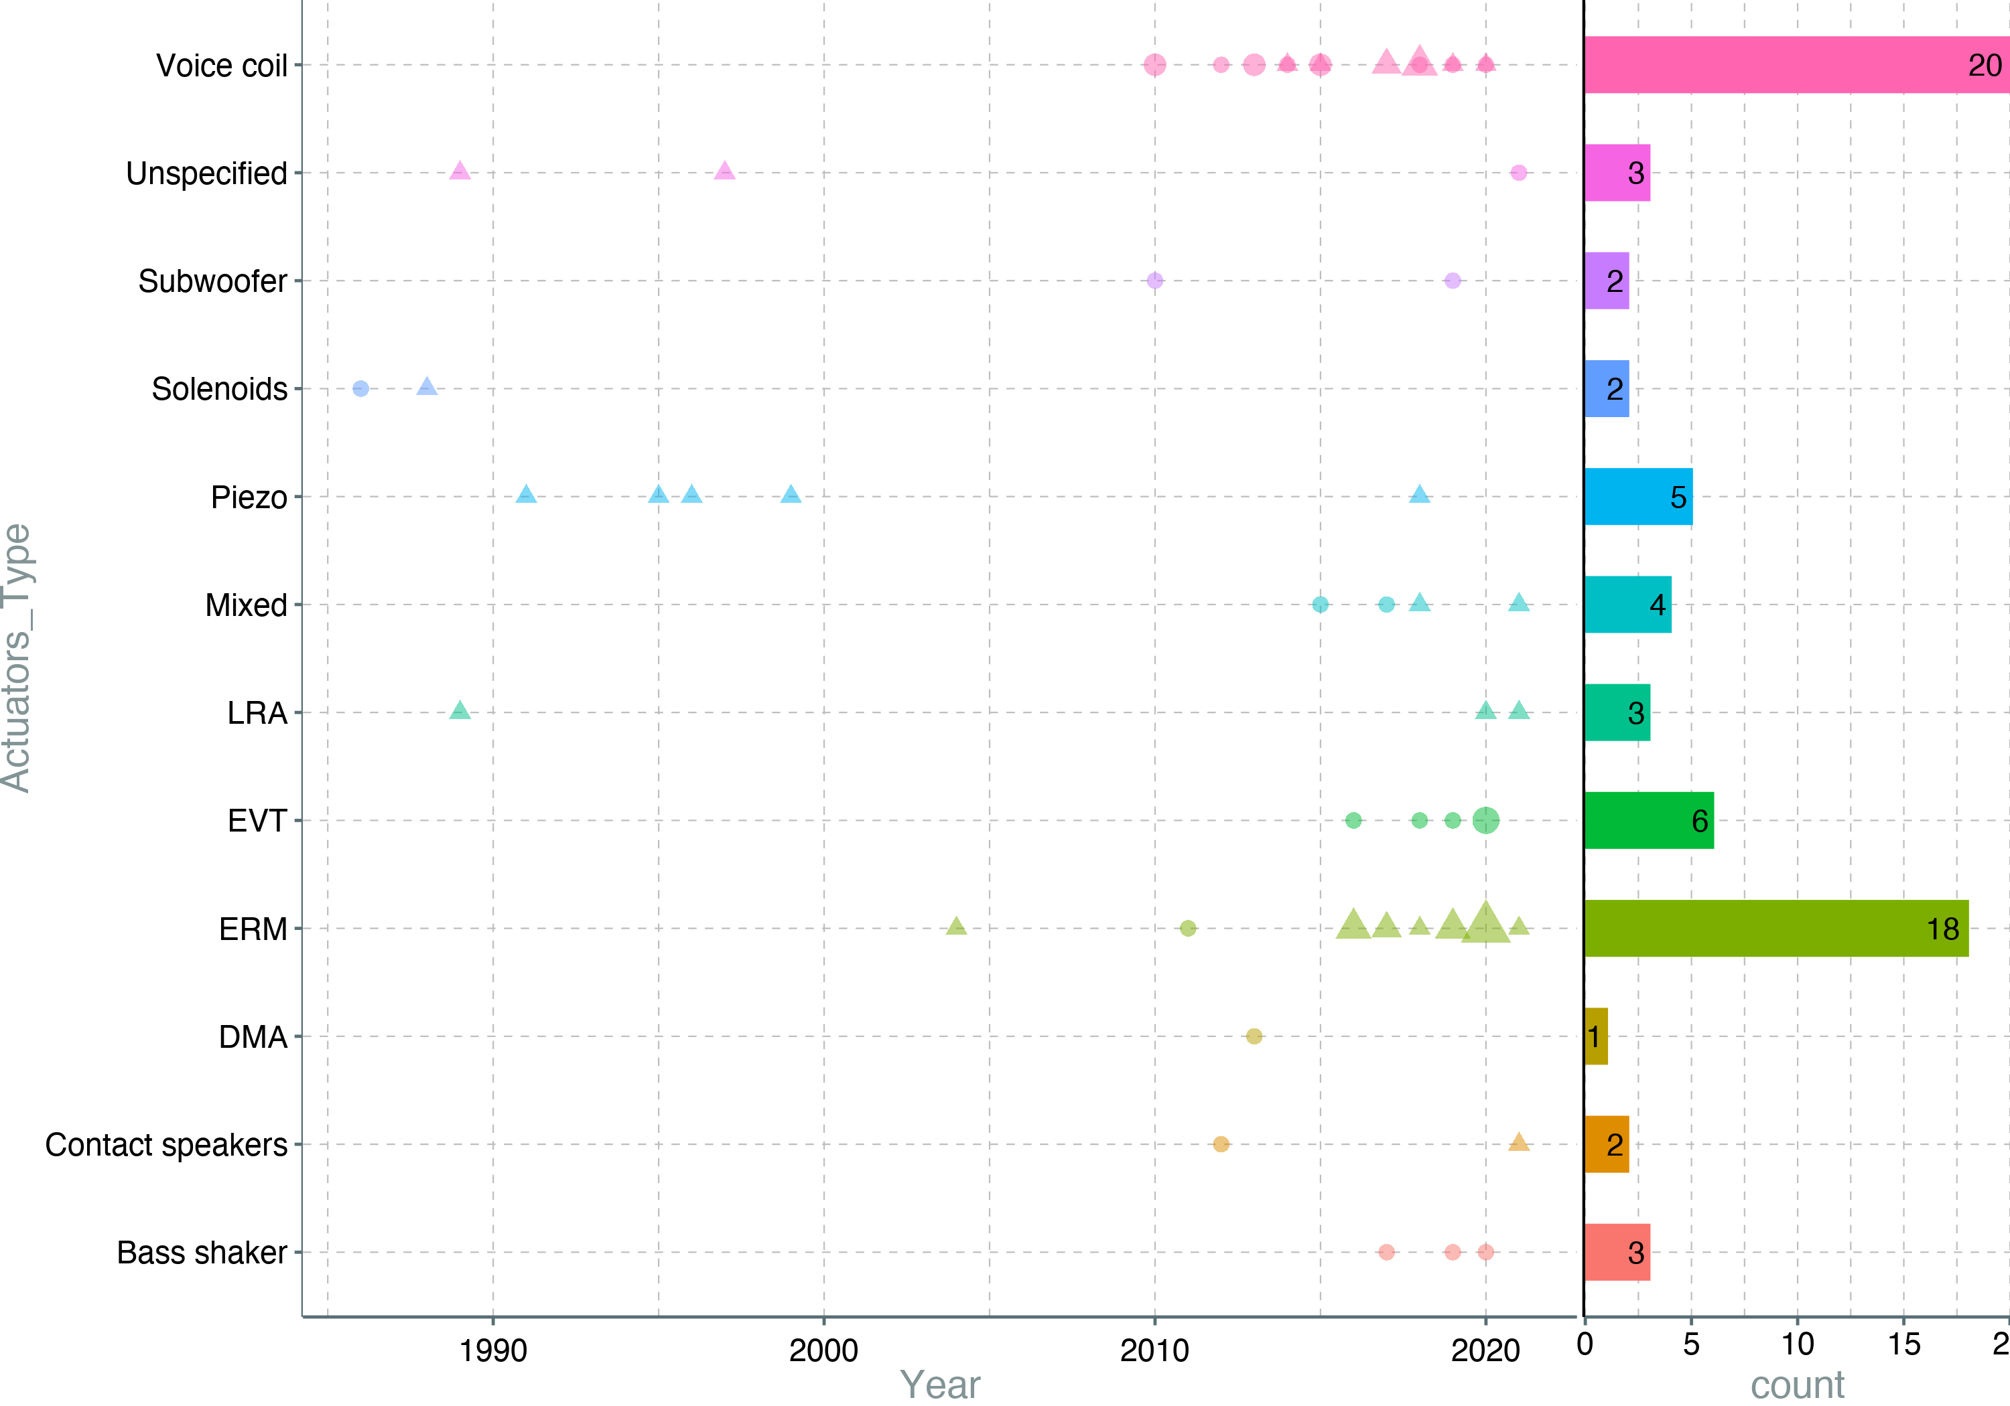
Notes:
We can see that voice coils have been used since the resurgence of the research, and are generally preferred for applications that require higher frequency and amplitude accuracy. The drawbacks of this type of actuators is that they are generally larger, more expensive, and would require a more complex DAC to operate, since they use bipolar signals. Another popular choice is the ERMs, which are smaller, cheaper, and simpler to operate than voice coil ones, but provide limited frequency response, and the amplitude is compled to the frequency. Another observation that can be seen is that older systems used Piezo and solenoids, technologies that have a very limited application range with small amplitude, or small frequency response. If it would be to include subwoofers, contact speakers and bass shakers in the "voice coil" category, this amalgamation would represent 34%.

Slide 23
Notes:
This is a bit self explanatory; mapping scheme kind of dictates the type of DSP to used.

Slide 24
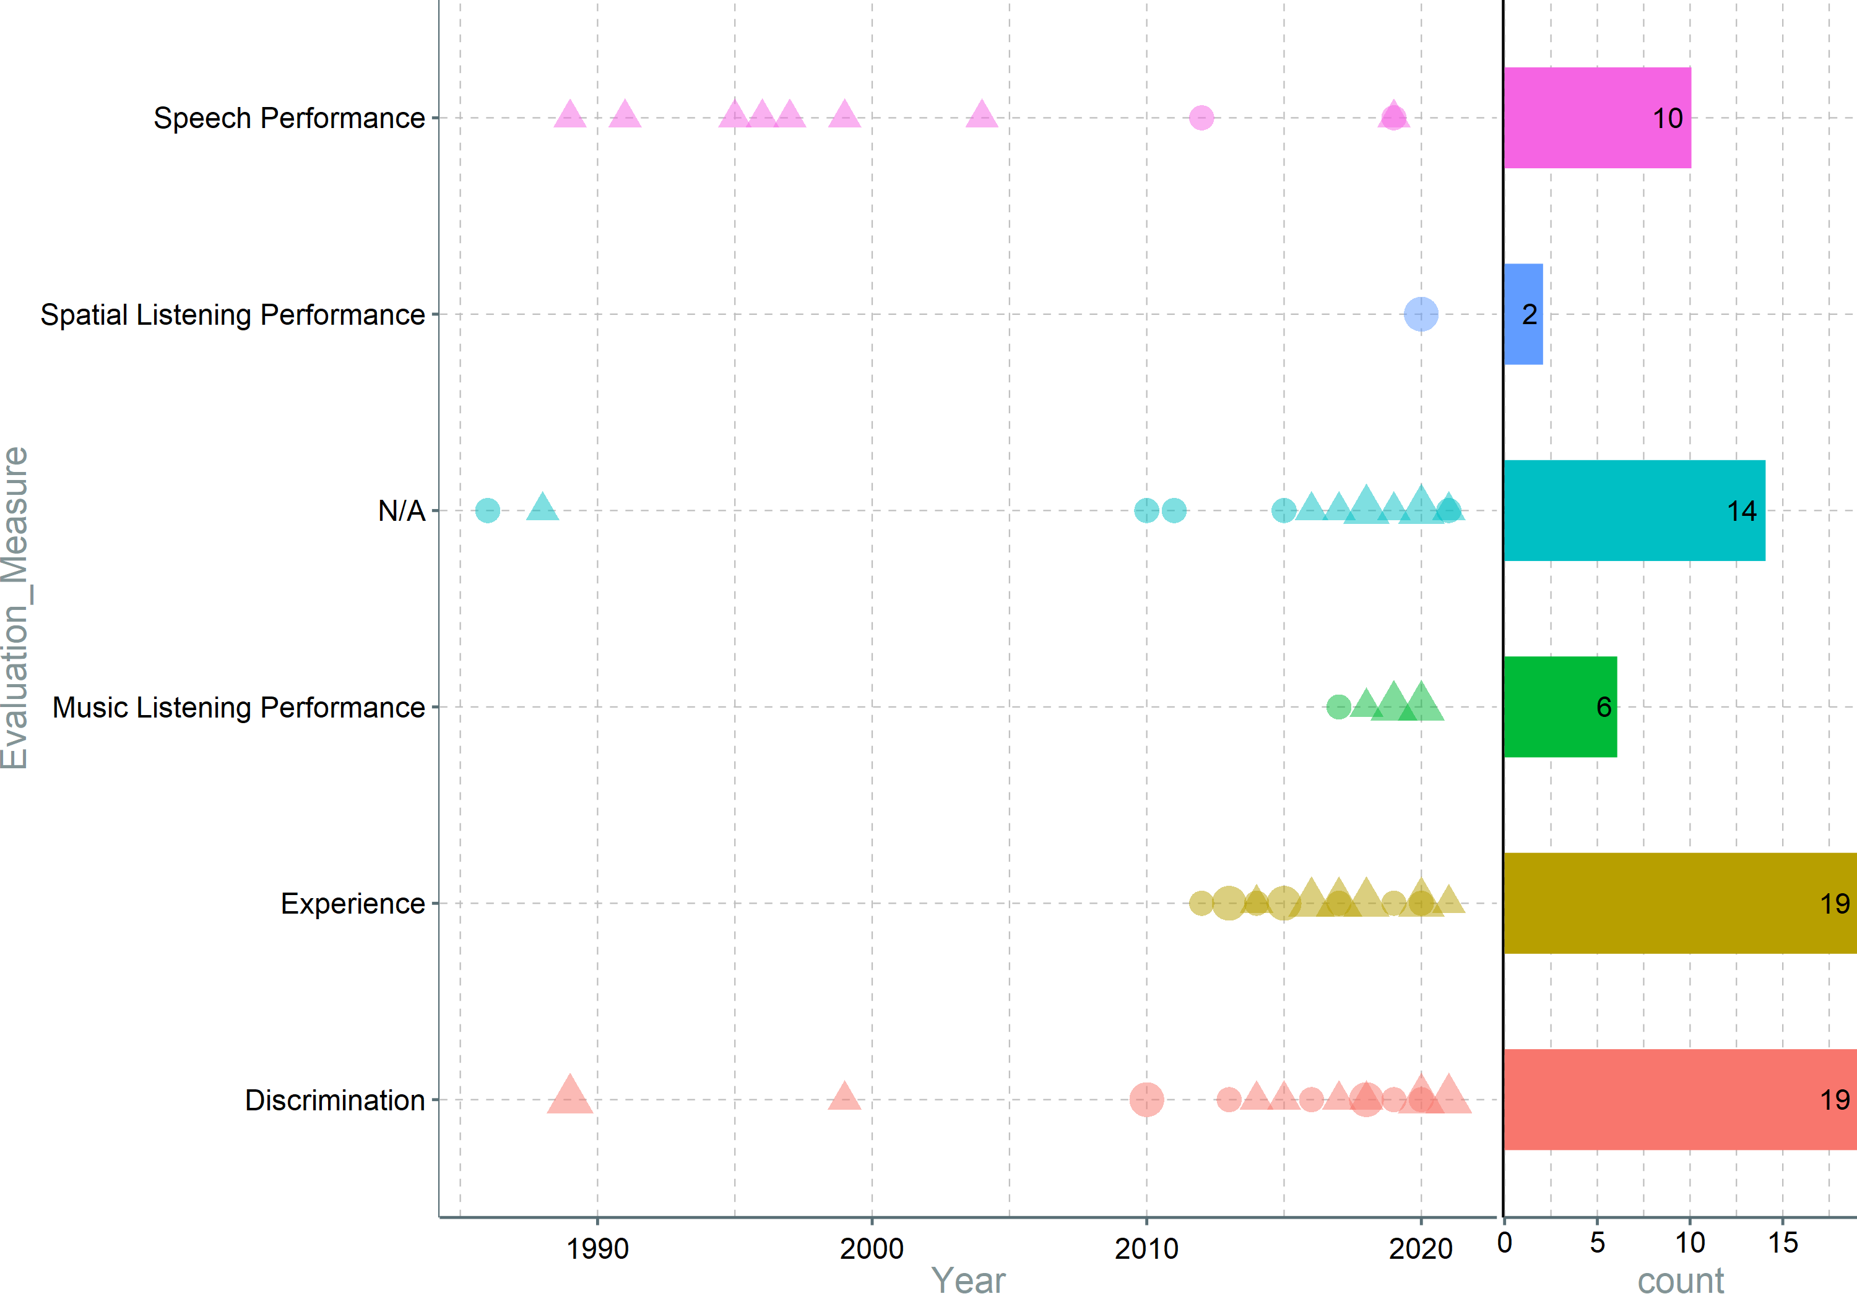
Notes:
It can be seen that speech research has been predominantly the focus before 2013, while music is the more interesting topic since. This can be explained by the advancement in HA and CI technology, that solved the speech inteligibility problem to a satisfactory degree, and the need to use tactile augmentation remains when music is present due to the problems HADs have with multi-stream, complex signals. At the same time, user experience has become a topic of interested in the second decade of the century, even though tactile augmentation research has been already going on at that point for over 30 years. A further look at the plot shows a big research between 2000 and 2010. (It would be nice to explain why the interest started again). At the same time, there is still an interest in finding the limits of physiological and cognitive systems involved in tactile perception and integration.

Slide 25
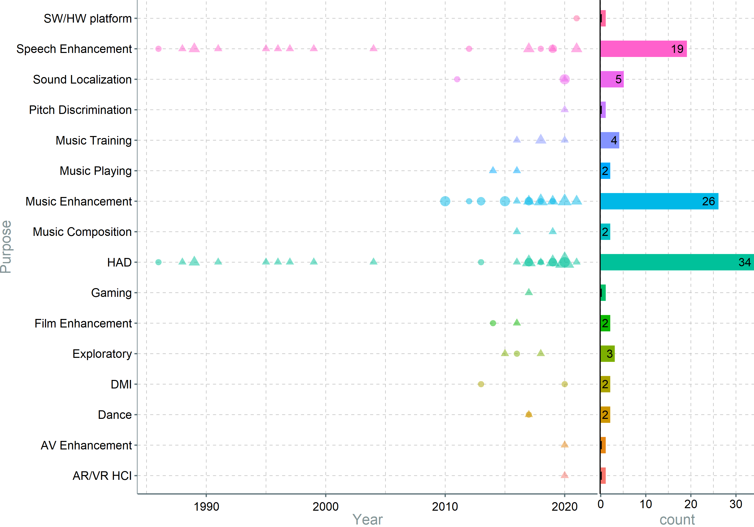
Notes:
A more detailed version of the previous graph, reinforces that speech enhancement has been a focus since the beginning of tactile augmentation. While the interest in it decrease in recent years, there are still researchers working on it. The second wave of tactile augmentation research started around 2010 and it focused mostly on music, but new technologies and media consumption methods sparked interest into tactile stimulation.

Slide 26
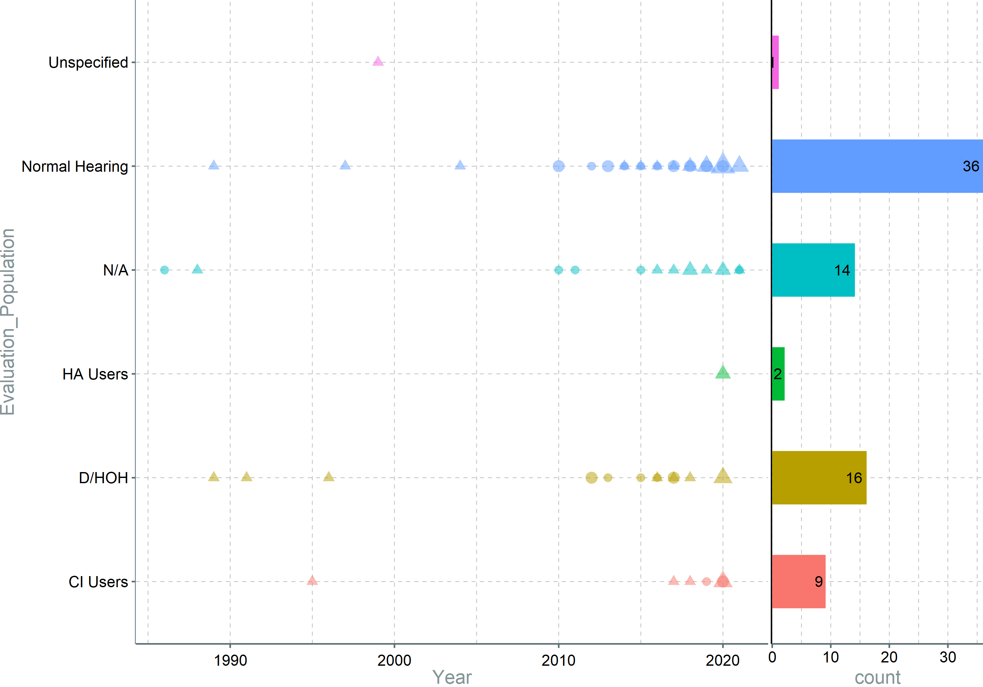
Notes:
Same old Normal hearing predominate – not so interesting

Slide 27
Notes:
Auditory tactile is used recently, probably because of the computational power available, but also because voice coil are mostly used recently. Pitch to position (the cochlear implant idea) is the one that is used the longest, probably because the creator of CI and tickle talker, used the same mapping for both. This could have been an inspiration to further research to produce incremental improvements of these systems, instead of revolutionary approaches. This change in the second part of 2010s.

Slide 28
